Slide 1
For Facilitator Succeed With These Slides
Support a step-by-step process to develop and implement an advocacy strategy using the SMART Advocacy User’s Guide.
Prepare before a SMART Advocacy facilitation and develop an agenda, talking points, relevant examples, and activities.
Reflect your advocacy issue, goal, and context by adapting slides, worksheets, and agendas.
Build in other SMART Advocacy materials.
Worksheets that result in a work plan
A guide for members of your working group
The SMART Advocacy Facilitator’s Guide for advice on how to tackle facilitation challenges
Notes:
“For Facilitator” slides mark decision points along the way in how you will organize and lead each SMART Advocacy phase and steps.
Make These Points
Suggested talking points for each slide will appear on each slide under “make these points” as demonstrated here.
Support the SMART Advocacy process
Read the full SMART Advocacy User’s Guide.
Review the worksheets and SMART Advocacy Facilitators’ Guide.
Learn as much as you can about the facilitation participants, their relationship to the issue, and any leadership roles (e.g., chair of a working group).
Prepare
Reflect on expectations for the SMART Advocacy facilitation you will lead.
Assess those who will be involved and ways in which to foster ideas, consensus and full participation.
Points that require audience participation will appear under “facilitate discussion” in the slide notes.
Consider the setting for your facilitation and whether your group will have electricity, laptops, WiFi, or will need to document findings and consensus on paper.
Prepare differently for in-person or virtual facilitation, building in breaks and energizers.
Reflect your advocacy issue, goal, and context
Customize agendas, worksheets, and slides to reflect your advocacy issue and goal, and fit the time you have.
Estimated time required for completing each SMART Advocacy step appear in the “For Facilitator” slide.
The slides do not now contain photos, but you may add photos and/or illustrations to any slide.
If a slide has many points, you may decide to separate them into several slides.
Reminders to adapt content on the slides will appear under “adapt the slide”.
Build in other materials
Use worksheets provided or interactive boxes included with the SMART Advocacy User’s Guide.
Review other resources on advocacy, facilitation techniques, and your issue.
If technology allows, use videos to illustrate key concepts or polling to test consensus.

Slide 2
For Facilitator Make Choices
Set the scope
Determine what you can accomplish in the time you have.
You may need multiple sessions or more time to accomplish all three SMART Advocacy phases.
Build in interactivity
Familiarize yourself with the suggested exercises and adapt them or add your own.
Decide whether exercises or activities will be done by the full group, break-out groups, individuals, or a mix.
Finalize the agenda and roles
Review sample agendas.
Build the schedule and exercises to your needs.
Assign roles—e.g., a note-taker, additional facilitators.
Notes:
Set the Scope
A suggested duration is indicated in the hidden facilitator slide for each step.
Timing varies according to the size of the group, their knowledge of the issue and advocacy opportunities, and their familiarity with SMART Advocacy.
Consider building in some ‘unallocated’ time to allow for flexibility and ensure that everyone can contribute to the discussion.
Build in Interactivity and Exercises
Instructions will appear in the speaker notes on the slides labeled for each exercise (e.g., 3.1, 3.2).
Decide before the facilitation whether they will be completed in plenary, in small groups, or a mix of the two.
Suggestions will be made in the speaker notes.
Finalize the Agenda and Roles
Assign roles for additional facilitators, leadership of exercises, etc.
Assign a notetaker or notetakers to document findings and consensus points.
Report-outs and note-taking suggestions from group work will be emphasized in the speaker notes under “facilitate report-out” and “document findings.”

Slide 3
For Facilitator Adapt the Slides
Review the deck
Hidden slides help you decide what to cover and how.
See instructions on how to hide/unhide slides in the speaker notes of this slide.
Customize slides before you facilitate
Every facilitation is unique.
Take time to customize the slides to reflect your issue and context.
Speaker notes suggest when adaptions are recommended.
Use related photos and other images. Sources include:
Images of Empowerment, USAID Global Health Bureau’s Flickr page, and free stock photo sites, such as http://search.creativecommons.org.
Notes:
Hide a slide by right-clicking on the small image of the slide on the left-hand side of the screen and then left-clicking on “Hide slide” in the menu that appears. You can make the slide visible again by repeating this sequence.
You also can hide a slide or make it visible by clicking on the “Hide Slide” icon in the “Slide Show” drop-down menu at the top of the screen.
If possible, pre-test photos, images, and quotations with relevant stakeholders before conducting the actual session.
For all photos, images and quotations, include credits. Note that many photos and images found on the Internet still require credits and sometimes permission to be used publicly.

Slide 4
For Facilitator Landscape Assessment
There are 3 options for SMART Advocacy Step 1.
Conduct the landscape assessment before the facilitation.
Share pages 14-18 of the SMART Advocacy User’s Guide with participants at least one week prior to the facilitation.
Ask participants to review questions before the facilitation and prepare to share their answers.
Use time dedicated in Step 1 for them to share their answers.
Ask a relevant official or other expert to review the landscape and prepare a report before or present it during the facilitation.
Use time dedicated in Step 1 for the presentation.
Ensure an opportunity for others to add to the review or add an alternate view.
Conduct the landscape assessment during the facilitation.
Follow Step 1 instructions on slide 17.

Slide 5
For Facilitator Welcome and Overview
Before the session:
Prepare flip chart sheets, a whiteboard, or slides to gain consensus on:
Expectations—What do participants hope to gain out of the session?
Ground Rules—How do you want to ensure full participation and respect for differences of opinion?
Parking Lot—Which issues are important to address, but may come later in the SMART process?
“SMART” with the acronym spelled out—a visual aid for ensuring that proposed advocacy objectives are SMART.
Send an agenda in advance and make it available at the session.
Decide how to use worksheets—collectively in one sheet, in small groups, or individually.
Notes:
This is your opportunity to set expectations and orient your working group to what’s ahead.
Consider how to transfer information to the worksheet that will serve as your work plan.

Slide 6
Facilitation PowerPoint
Notes:
Facilitate discussion:
What is your experience, if any, using the SMART Advocacy approach? (If no one is familiar, you may want to share your own experience)
What are your hopes for this session? What do you expect to gain or accomplish? Note outcomes on the “Expectations” flip chart sheet or whiteboard.
Set ground rules for the session and make sure they are recorded on the appropriate flip chart, whiteboard, or slide. Make sure inclusion of and respect for differences of opinion is mentioned.
Consider an icebreaker or energizer to set the stage for open discussion and introduce every participant. Use name cards or memorize their names if you can.
Mention that your job is to facilitate consensus on decisions, not to set the agenda yourself or to ‘teach’ the approach.

Slide 7
What is SMART Advocacy?
Focuses on the potential to advance a long-term goal through short-term advocacy gains
Assesses opportunities for collective action and makes choices
Identifies the right decision-maker
Anticipates what will motivate the decision-maker to act
Notes:
Make these points:
In this introductory session we will define SMART Advocacy and introduce the SMART Advocacy cycle.
SMART Advocacy is a systematic process for developing and carrying out a strategy to influence key decision-makers and request and secure action.
User’s Guide pages 5-7.

Slide 8
Overview
Goal
Long-term outcome that advocacy seeks to achieve
Objective
A near-term outcome that contributes to the goal
Advocacy win
A discrete, critical policy or funding decision that meets a short-term objective.
A series of advocacy wins add up to achieve the goal
Notes:
Make these points:
Developing an effective strategy requires understanding these key concepts and definitions
Read definitions of goal, objective, and advocacy win from the slide.
AFP’s approach to advocacy focuses on actions that will have the greatest impact in the near term. These near-term successes—or “advocacy wins”—add up to achieving the broader, long-term goal.
“Near term” usually means what can be accomplished within 6 months to a year.
Facilitate discussion:
Ask participants to share examples of advocacy wins that they have seen or been involved in. You can use the following prompting questions:
What made this advocacy effort successful?
Did this advocacy win help advocates progress toward an overall goal?
Consider using an example that is unrelated to your advocacy issue
Example—Your goal is to become physically fit. What is the first objective?
Make sure to fit your example to the cultural context.
Stop and ask if any clarification is needed.
User’s Guide pages 89-91.

Slide 9
Definitions and Key Concepts
Key to an advocacy win:
A SMART objective
Specific
Measurable
Attainable
Relevant
Time-bound
Notes:
Make these points:
Read the acronym “SMART” on the slide and explain each of the SMART criteria.
Reveal your SMART flip chart sheet (or whiteboard) and mention that you will revisit the concept in Step 3 and at key steps along the way.
The approach also allows advocates to break up their advocacy into actionable steps.
Refer to flip chart sheet or whiteboard with acronym spelled out to ensure group can review what SMART means throughout the facilitation.
Optional: Note that the SMART acronym is a 30-year-old concept first applied to project management in business.
Ask for any questions.
If you have used an example with the prior slide, you can apply SMART to sample objectives
E.g., doing 25 sit-ups every other morning for a year is SMART. Exercising and eating better is not SMART.
User’s Guide page 5.

Slide 10
Notes:
Optional: Distinguish SMART Advocacy, activism and behavior change communication.
Make these points:
One question users ask about SMART Advocacy is, “how does SMART Advocacy differ from other approaches?”
SMART Advocacy is often confused with social behavioral change communication and activism.
Each methodology has a place in creating change but uses different tactics.
Social behavioral change communication shifts norms and behavior in a larger community to create change.
Activism builds collective action and pressure to achieve change.
SMART Advocacy leverages key decision-makers who can enact change and relies on near-term advocacy wins that add up to larger gains in the long term.
Typically, activism and social behavioral change communication require more time and resources.
User’s Guide page 6.

Slide 11
The Secret to an Advocacy Win
Focus energy and attention on:
opportunities for action that have
the highest potential for impact
in the near term
Notes:
Make this point:
SMART allows advocacy working groups to identify opportunities for action that have the highest potential for impact in the near term.
Optional:
You might ask for or share examples.

Slide 12
Types of Advocacy Wins
Funding | By December 2021, the Lira district budget for community health worker training increases by 50%
Policy | By mid-January 2022, the Central Kampala City Commissioner signs an ordinance to schedule fixed days for waste pick-up in Central Kampala division
Visibility | The Ugandan Government announces a Family Planning 2030 (FP2030) commitment at the International Conference on Family Planning on November 11, 2022
Notes:
Adapt the slide: Replace examples with local examples, preferably actual but, if not actual, hypothetical.
Ask a participant to read examples of advocacy wins from the slide. If possible, choose a participant familiar with these advocacy wins.
Make these points:
Advocacy wins generally fall within one of 3 categories: (1) increased funding, (2) change in policy or implementation of an existing policy, or (3) improved visibility of your issue.
These advocacy wins contribute to broader goals—such as more funding for health care services, a clean environment, or increasing the government’s commitment to family planning.
Alternative wins (family planning)
Funding: By December 2021, district budgets for village and workplace family planning services increase by 50%.
Policy: By mid-January 2022, national family planning guidelines are amended to allow community-based distribution of injectable contraceptives.

Slide 13
SMART Advocacy Strategy in 9 Steps
Notes:
Choose either this slide or the next to display and hide the one not to be shown (see slide 3 for how to hide slides).
Read the names of each step and explain each briefly.
Make these points:
SMART Advocacy has a 3-phase process for effective strategy development. The three phases are building consensus, focusing efforts, and achieving change.
Each phase consists of 3 steps, for a total of 9 steps. We will focus on the first two phases and six steps. The last phase and steps are intended to support your advocacy implementation and restarting the advocacy cycle.
We will discuss each of these phases and steps in detail, and you will create your own advocacy strategy as we go along.
Make the point that this is an advocacy process that allows you to continuously move forward and adapt to changes in the landscape (e.g., a new policymaker, national plan, or advocacy opening).
User’s Guide pages 8-9.

Slide 14
SMART Advocacy Strategy in 9 Steps
Phase 1
Build Consensus
Step 1
Understand the Landscape
Step 2
Decide Who to Involve
Step 3
Set SMART Objective
Phase 2
Focus Efforts
Step 4
Know the Decision-maker
Step 5
Determine the Ask
Step 6
Create a Workplan
Phase 3
Achieve Change
Step 7
Present the Case
Step 8
Monitor the Plan
Step 9
Capture Results
Notes:
Alternative graphic to represent the advocacy cycle. Use this graphic if you want to change the order of the steps to suit the needs of your group.
Read the names of each step and explain each briefly.
Make these points:
SMART Advocacy has a 3-phase process for effective strategy development. The three phases are building consensus, focusing efforts, and achieving change.
Each phase consists of 3 steps, for a total of 9 steps. We will focus on the first two phases and six steps. The last phase and steps are intended to support your advocacy implementation and restarting the advocacy cycle.
We will discuss each of these phases and steps in detail, and you will create your own advocacy strategy as we go along.
User’s Guide pages 8-9.

Slide 15
SMART Advocacy Guiding Principles
Locally-driven
Focused
Evidence-based
Collaborative
Influential
Accountable
Sustainable
Notes:
Optional: Applying these 7 guiding principles throughout SMART Advocacy strategy development will improve the chances of success.
Briefly explain each of the guiding principles.
Locally-driven—Local champions set priorities and lead strategies.
Focused—Efforts are targeted and pinpoint the key decision-maker who controls funds and sets policies.
Evidence-based—Advocacy based on data drives practical and impactful change.
Collaborative—An inclusive process gains consensus and leverages diverse resources.
Influential—Those affected by the issue are the most powerful advocates.
Accountable—Specific performance benchmarks help you monitor, evaluate, and learn from progress as well as from setbacks.
Sustainable—Advocacy results are more likely to be sustained when advocacy capacity is built into local processes, organizations, and systems.
User’s Guide page 10.

Slide 16
Phase 1: Build Consensus
Notes:
Make these points:
When beginning to develop a SMART Advocacy strategy, you will focus on building consensus on the issue you want to address.
In this phase, you will assess and understand the landscape surrounding your issue in Step 1, decide who to involve and build your advocacy working group in Step 2, and identify advocacy opportunities and set a SMART objective in Step 3.
User’s Guide page 11.

Slide 17
For Facilitator Step 1
Set aside at least one half-day for this step if conducting during the workshop; if assigned as pre-work, set aside 1.5 hours to present and discuss findings.
Before the session:
Review slide 4 and the speaker notes of this slide to determine your approach to Step 1.
Adapt slide 19 with locally relevant images.
Notes:
As stated on slide 4, the facilitator has three options: 1) group members conduct the landscape assessment before the facilitation, 2) a consultant or expert conducts the landscape assessment before the facilitation and presents findings during the facilitation, or 3) the group works on an initial assessment during the facilitation.
If the landscape assessment is conducted before the facilitation, have a group member present a brief summary of the landscape assessment findings (10- 20 mins). For option 2, it often helps to have government officials present the landscape assessment.
If conducting the landscape assessment during the facilitation, unhide slides 21-24. Ask each group to discuss the questions on slide 21-24 and to write their answers on flip chart sheets, a whiteboard, or worksheets. Facilitate the report-out of their findings.
Facilitation Troubleshooting:
If the group struggles to find common ground in 1.1 and 1.2, organize a prioritization exercise using sticky dots, annotation in a virtual whiteboard, or poll, wherein each participants has 3 choices on which topic to continue focusing their strategy on. Mention that subsequent steps will enable them to narrow in on what actions they would like to take.

Slide 18
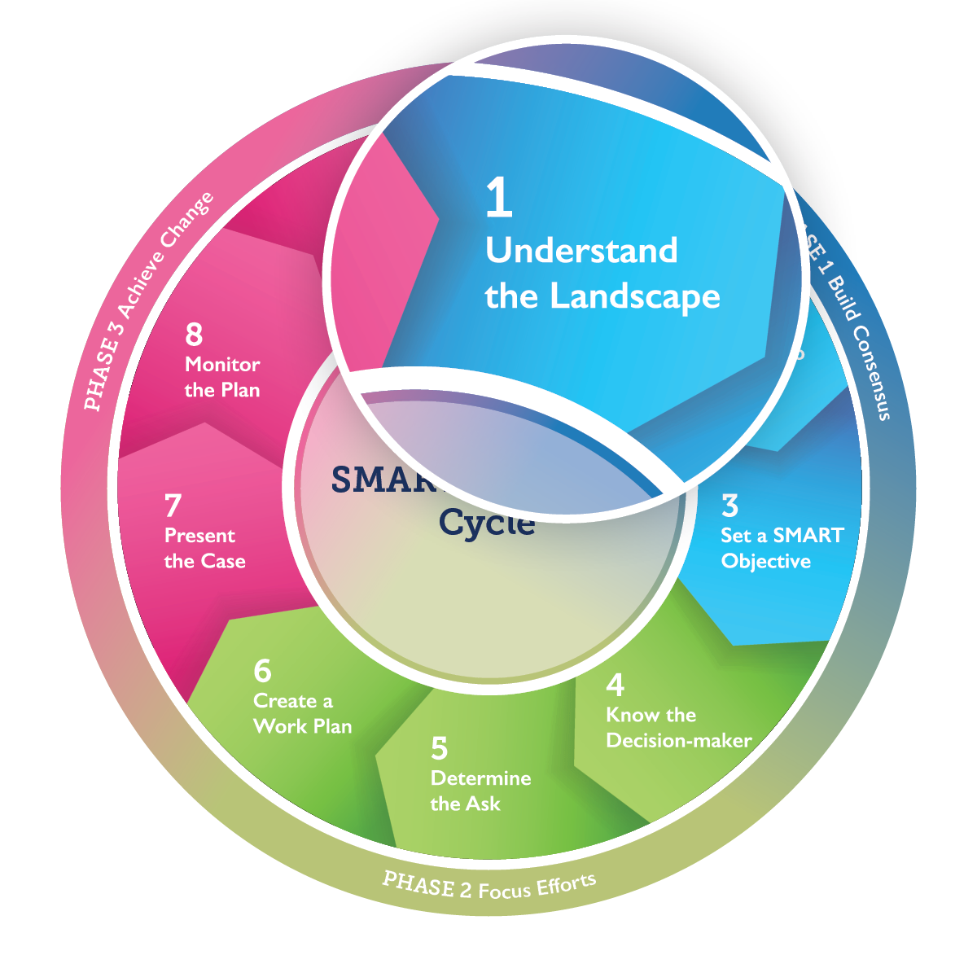
Step 1 Outcome:
Advocacy Opportunities
Notes:
By the end of this step, you will have a list of strategic advocacy opportunities based on evidence.
Make these points:
Before you embark on a journey, you need a map. Likewise, to develop an effective advocacy strategy, you need an in-depth understanding of the overall environment—or landscape—surrounding your issue. A review of the context—also called a landscape assessment—can help us consider external opportunities and challenges.
In this step, you will consider all opportunities affecting your issue and identify possible advocacy entry points.
User’s Guide pages 12-18.

Slide 19
Step 1—Understand the Landscape
Placeholder
Insert photos or statements representing the decision-making landscape—for example, quotations about your issue from decision-makers or other influential individuals or bodies
Notes:
Adapt the Slide:
On the slide, replace the placeholder with photos or statements that reflect the environment in which the strategy will be implemented.
Facilitate discussion:
How might decision-making contexts/environments differ? How might an advocacy strategy need to change depending on where it is implemented?
Make these points:
A small group of committed people with relevant knowledge from different viewpoints can usually make the best assessment.
This group may be the nucleus for the advocacy working group that will develop and carry out the strategy.
While implementing your advocacy strategy, you should continuously revisit your assessment from time to time to see what has changed or is changing and realign your strategy as needed. What works in one location, or one set of circumstances might not work somewhere else or at another time.
User’s Guide pages 12-13.

Slide 20
1.1 Assess the Landscape for Your Issue
Environment
Evidence
Actors
Policy
Notes:
Assign exercise 1.1 or ask the individual or group assigned the exercise as pre-work to present their findings.
Instructions: You will now start assessing your own landscape. Use evidence and knowledge to understand how to focus your advocacy. What issue will your advocacy strategy address? What are the opportunities for and obstacles to addressing the issue? What is the level of support and opposition? How is the issue addressed in official plans, commitments, strategies, or goals?
Consider everything you know or can learn about your issue—from official statistics to expert opinions to knowledge from fellow advocates. Gather as much detailed relevant information as you can, starting with the questions in 1.1 on your worksheet.
Report findings: Ask presenter(s) the best opportunities that they have identified, and the challenges involved. Ask the other participants if these points resonate with them.
User’s Guide pages 13-17.

Slide 21
Landscape Assessment: Environment
What issue will your advocacy strategy address?
What are the opportunities for and obstacles to addressing the issue (e.g., elections, natural disaster)?
What is the level of support and opposition?
What related issues are of higher priority on the decision-makers’ agendas?
What are alternative proposals for action on your issue or other issues that are competing with yours for policy-makers’ attention?
Notes:
Unhide if conducting landscape assessment during facilitation. Ask small groups to do their best to answer ALL the questions.
User’s Guide page 14.

Slide 22
Landscape Assessment: Actors
Which specific decision-makers are best able to take action on policy or funding related to your issue?
Which civil society organizations, religious groups, businesses, etc. play a leadership role in the issue?
Who are the champions and influential experts on the issue?
Who else is working in this advocacy arena, and what are their goals?
For all actors, what are their values and viewpoints?
Notes:
Unhide if conducting landscape assessment during facilitation. Ask small groups to do their best to answer ALL the questions.
User’s Guide page 15.

Slide 23
Landscape Assessment: Evidence
What data define the scope of the issue?
Who is affected by and who will be a beneficiary of a policy or funding decision?
What policy actions will be effective in addressing the issue? How strong is the information?
Do current policy and funding priorities align with evidence?
Notes:
Unhide if conducting landscape assessment during facilitation. Ask small groups to do their best to answer ALL the questions.
User’s Guide page 16.

Slide 24
Landscape Assessment: Policy
What are the current or promising policy and funding priorities that address the issue?
What is the policy-making process in your context?
What is the current budget, spending, and budget process on the issue?
Which other policies, events, or directives (existing or pending) are more relevant to your issue and how?
How has your issue been addressed in official plans, commitments, or strategies?
Are there also advocacy efforts at the regional, national, or global level?
Notes:
Unhide if conducting landscape assessment during facilitation. Ask small groups to do their best to answer ALL the questions.
User’s Guide page 17.

Slide 25
1.2 Find Advocacy Opportunities
Notes:
Facilitate discussion:
Identify your advocacy working group’s strategic openings.
What advocacy opportunities and obstacles do you see in your landscape?
Which of these opportunities—new leadership, policy developments, community needs—would allow you to achieve an advocacy win within the next six months?
Weigh opportunities against the obstacles.
Which individual decision-makers are most likely to be a champion for or have the power to act on your issue? It is important to list them by name and title.
Make these points:
The landscape is never static. The landscape assessment should be updated periodically to keep refining your strategy.
The assessment serves as a benchmark for comparing any changes from the current situation surrounding your issue as you pursue your desired goal.
Document findings on PowerPoint, flip chart, worksheets or whiteboard. This is likely the first information to save—take a photo of the flip chart sheet or white board. If the white board is being used on a virtual platform (e.g., Zoom, Microsoft Teams, etc.) familiarize yourself with how to save information for later use or take a photo of your screen.
User’s Guide page 18.

Slide 26
For Facilitator Step 2
Set aside about 30-45 minutes for this step.
Before the session:
Prepare a flip chart sheet or whiteboard titled “Missing Key Stakeholders” that all can see or use the worksheets or slide 30.
During the session:
When discussing additional members for the advocacy working group (slides 28-29), you may want to refer to the checklist in the speaker’s notes of this slide or on page 23 of the User’s Guide to check whether any important participants are missed.
Notes:
Stakeholder Inventory Checklist
Does your advocacy working group include:
People with influence and access to those in power
Professionals with relevant expertise
Informants who can shed light on government processes
Healthcare providers, other professionals, or community members with first-hand knowledge of your issue
A monitoring, evaluation, and learning (MEL) expert with access to key data
Potential beneficiaries of a policy or funding decision
A facilitator who can lead positive discussions, mediate disagreement, and keep the group on track.

Slide 27
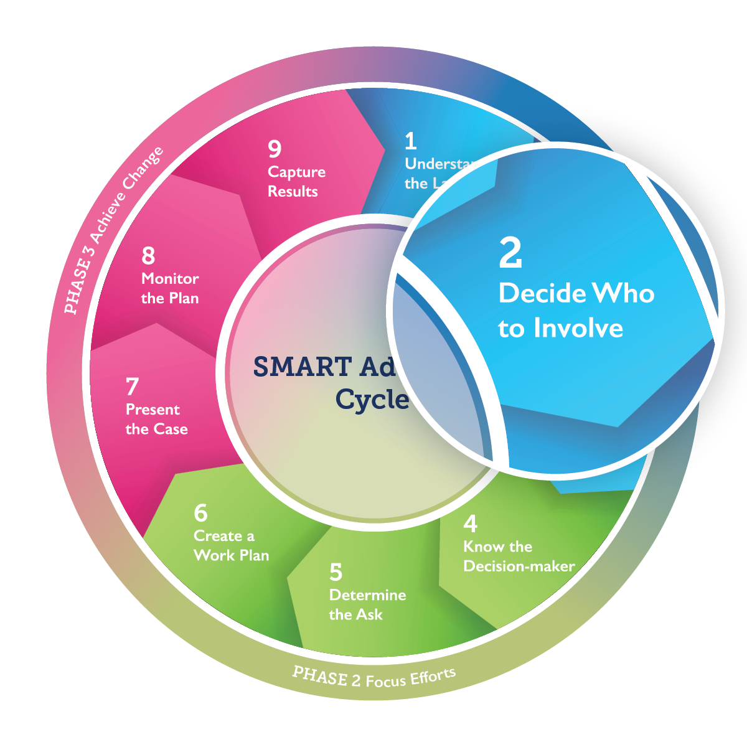
Step 2 Outcome:
Key Stakeholders Inventory
Notes:
At the end of this step, you will have developed an inventory of key stakeholders.
Make this point:
The chances of success are greatest when the right people come together, as the advocacy working group, to develop the advocacy strategy.
User’s Guide pages 19-23.

Slide 28
Step 2—Decide Who to Involve
Who are critical champions in the government, parliament, donor agencies, or other organizations?
Are there private-sector organizations or business leaders who are relevant to reaching your objective?
Which NGOs or professional associations share your agenda?
Can faith-based organizations or media outlets help reach your goals?
Notes:
Make these points:
The next step is to think about specific organizations and agencies in your area that are already engaged on this issue or who could be engaged.
Who else might be helpful in your working group? (Read the questions on the slide).
A broad range of stakeholders can lend their expertise and bring unique perspectives.
Any advocacy working group will have a core group of dedicated members who are strongly committed to change. At the same time, inviting the participation of influential people who are not yet strong advocates can strengthen their commitment and contributions.
User’s Guide pages 20-23.

Slide 29
Step 2—Decide Who to Involve
Have you included people with expertise and experience relevant to your issue?
Have you considered people who are influential and have access to decision-makers?
[Photo placeholder]
Notes:
Adapt the Slide:
On the slide, replace the placeholder with a locally relevant photo or image.
User’s Guide pages 20-23.

Slide 30
2.1 Inventory All Stakeholders
List individuals who can help you act on your advocacy opportunity.
Individual’s Name | Organization and position | Phone | Email | Priority for Inclusion | Notes
Notes:
Assign 2.1:
Who do you need to help you act on your advocacy opportunity? Brainstorm individuals and organizations that can be potential allies. Add their contact information and put a check in the “Priority for Inclusion” column if the contact is critical to your advocacy.
Facilitate report-out and document findings:
Have participants write their answers on a flip chart sheet, whiteboard, or on their worksheet.
The group can reference the checklist on page 23 of the User’s Guide.
User’s Guide pages 21-23.

Slide 31
For Facilitator Step 3
Set aside at least 3-4 hours for this step and keep the facilitation plan flexible in case the group needs more time to reach consensus. Schedule a break between exercise 3.2 and the report-out.
Before the session:
Prepare a flip chart sheet or whiteboard where all can see titled “Prioritizing SMART Objectives,” with the following questions:
Which is the highest priority?
Which is most achievable in the short term?
Which has the greatest potential to help reach your long-term goal?
Which must be achieved BEFORE other objectives can be addressed?
Review tips on facilitating the small group work in Step 3 in the facilitator’s guide.
Adapt slide 38 to use a local example if possible.
Notes:
Step 3 Facilitation Troubleshooting:
When a group’s objective lacks specificity:
Tell the group to state their objective as an outcome so that they know when the strategy succeeds or when they need to regroup.
Tell the group to make sure the decision-maker is specific enough; “the government” is not a decision-maker. Who in government makes the decision?
Ask the group:
Would a stranger understand what you are trying to achieve? Is your objective explicit and precise?
Does the objective state a key outcome, a timeframe, and a decision-maker who can make it happen?
When a group confuses goals and objectives:
Tell the group to imagine that their goal is to make their community safe for children. Then ask, “What possible first steps in advocacy would you need to take? What would your first, second, and third objective be?”
Ask the group:
What can you achieve now to contribute to your long-term goal?
What are important incremental steps toward reaching your goal?
When a group proposes activities instead of objectives:
Tell the group that they will carry out activities—but a decision-maker will have the ultimate say on whether to take action to meet your objective.
Ask the group:
How could you use this activity to contribute to a SMART objective?
When a group is unable to prioritize one objective:
Tell the group to think about ways in which multiple objectives may be more difficult to manage. Emphasize that more challenging objectives can be addressed in future strategy sessions.
Ask the group:
Are any of the objectives you have set more important than others?
If all are equal, how will you coordinate parallel efforts and what kinds of resources will you need?
When a group is unable to gain consensus on one objective:
Tell the group to assess objectives according to the most impactful and near term. Record secondary objectives for additional strategy sessions.
Ask the group:
From the list that has been developed, which of these will have the biggest impact?
What can be achieved in the near term?
How can you balance both impact and your timeline in choosing one objective?

Slide 32
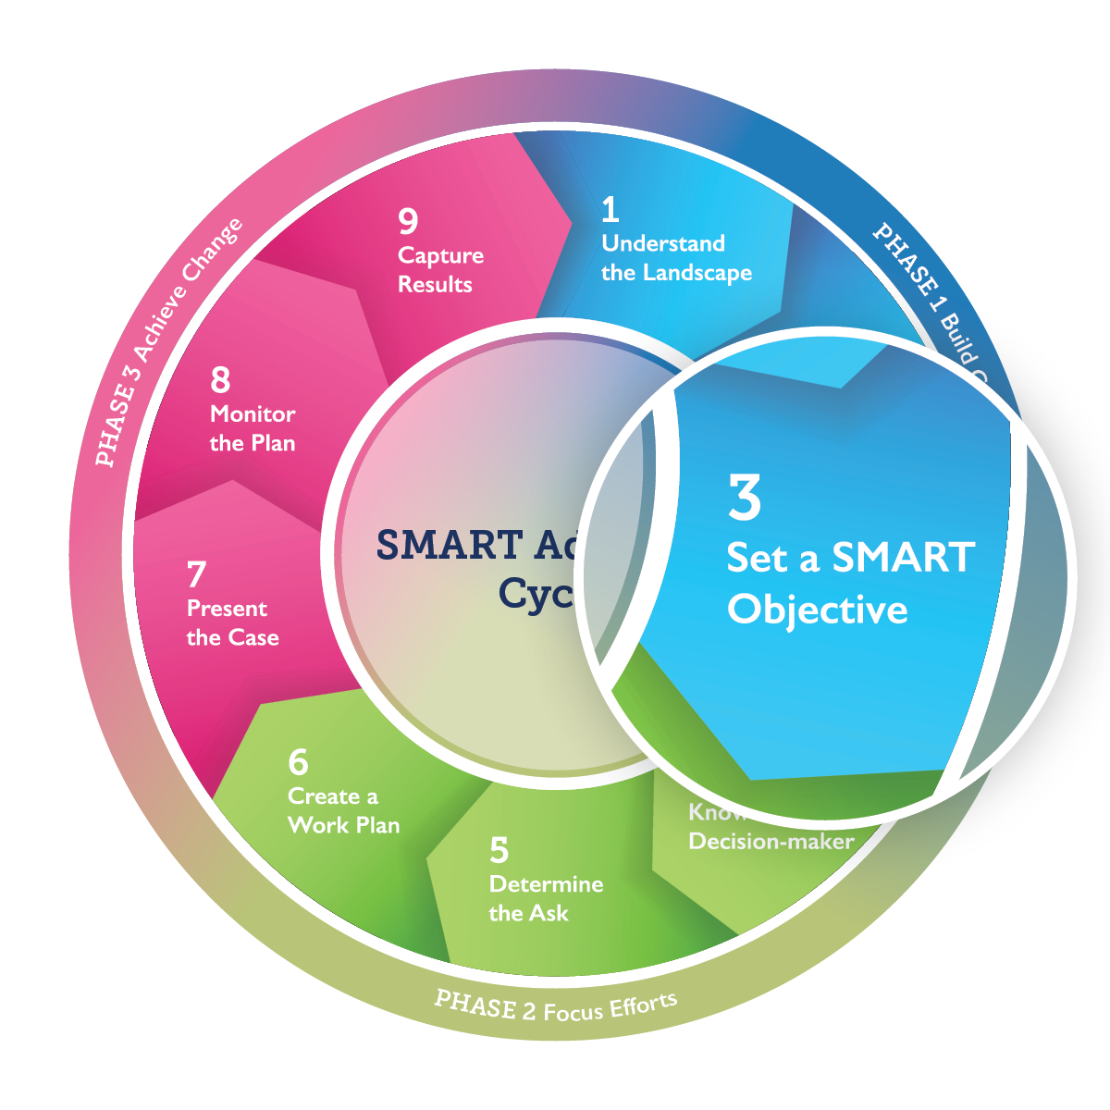
Step 3 Outcome:
Advocacy Goal and SMART Objective
Notes:
At the end of this step, you will have specified an advocacy goal and set a first SMART objective.
Make these points:
Every advocate dreams big. But to reach your goals, you also must focus on near-term, incremental progress. Something you can accomplish in 6-12 months.
In Step 3 you will identify a SMART objective focused on an advocacy win. This objective will answer the question, “What are you really trying to accomplish, and what can you do about it now?”
If you identify many challenges or significant opposition, you will need to consider them when setting your objective.
User’s Guide pages 24-30.

Slide 33
Goal
An ambitious, long-term change; the ultimate purpose of your advocacy
Examples:
Reduce maternal deaths by 20% in the next decade
All family planning providers can offer the full range of contraceptive methods
100% child vaccination worldwide
Notes:
Facilitate discussion:
What does a good goal statement look like? Ask participants for their thoughts. Some answers may include:
A goal is ambitious. It will take time to achieve, and it is worth the time and effort.
A goal statement is clear and easily understood, even by those not familiar with the issue.
A goal is inspiring and will attract the commitment of advocates and support of decision-makers and the public.
A goal is in sync with broad national policy goals.
Ask for examples of goals of all types—business, government, personal.
User’s Guide pages 24-25.

Slide 34
3.1 Agree on a Long-Term Goal
State a concise, long-term advocacy goal
Notes:
Assign 3.1.
Ask participants to work together to propose a goal in plenary or in small groups.
If the working group already has a goal, confirm that it is still in operation and skip step 3.1.
Facilitate report-out: If assigned in small groups, ask the groups to present their proposed goal statements to the entire group.
Document findings on a flip chart sheet, worksheet, or whiteboard.
Facilitation Tips:
Review your landscape assessment to formulate or build consensus on a goal that states clearly the change that you hope to see as a result of your efforts.
If they are formulating a goal for the first time, consider various options, including what will best inspire strong commitment. Regardless, take the time to discuss and debate.
This is the most important step to gaining the consensus. It is the critical unifier in establishing or energizing an advocacy working group.
User’s Guide pages 24-25.

Slide 35
Step 3—Set SMART Objective
Objective: a short-term improvement sought, the focus of your SMART Advocacy strategy
Examples:
The president of the midwifery association will adopt a new in-service training to manage hemorrhage by September 2022
The district health official creates a budget line for family planning commodities by December 2022
Large private company adds child vaccination coverage to its health insurance policy by January 2023
Notes:
Facilitate discussion:
What is the difference between a goal and an objective?
Make these points:
Objectives are small, incremental steps. You reach your goal through a chain of these “advocacy wins.”
Objectives often take advantage of imminent policy windows.
Optional activity:
Prepare ahead a list of examples of possible goals and objectives appropriate to the local context.
Read each example. Discuss with participants whether it is a goal or an objective.
User’s Guide pages 26-30.

Slide 36
Step 3—Set SMART Objective
What are you trying to accomplish and what can you do now?
Specific | indicates clearly and concretely what is to be accomplished
Measurable | uses quantitative or qualitative descriptors to track progress and gauge success
Attainable | is within reach
Relevant | contributes to the overall goal of your advocacy efforts
Time-bound | sets deadlines for achievement
Notes:
Make this point:
To drive advocacy efforts and achieve success, the objective must be SMART (have characteristics that qualify the objective as being specific, measurable, attainable, relevant, and time-bound).
(Read each of the 5 characteristics of a SMART objective on the slide.)
Facilitate a discussion:
How does a SMART objective facilitate an advocacy win? Use an example that will be familiar to the group or ask the group to share examples they feel are SMART.
Optional activity:
Create small groups and ask each to draft a SMART objective based on the landscape assessment and their own knowledge. They can note their objective on a flip chart or slide to share with the larger group. The larger group assesses how each group’s objective is SMART and how it could be made stronger. This exercise is particularly useful when a group is new to the SMART concept.
User’s Guide pages 26-27.

Slide 37
Many SMART Objectives to Reach One Goal
Notes:
Make this point:
Many advocacy wins—that is, meeting SMART objectives—are needed to reach the broader goal. In this example, the overall goal is reduced maternal mortality.
Review objectives 1 to 5 on the slide.
Facilitate discussion:
Do these objectives form a chain that leads to the goal?
Is it possible to achieve them in a different order?
What other possible objectives would help meet the goal?
Brainstorm how to define, measure, and verify success.
Ask for any questions on clarifying the differences between goals and objectives and the characteristics of a SMART objective.
User’s Guide page 30.

Slide 38
Many SMART Objectives to Reach One Goal
NOW
In a large state, many women are dying during pregnancy and childbirth.
GOAL Fewer women die in childbirth
Objective 1
The governor commissions a taskforce to track maternal mortality by June 2021
Objective 2
The State Minister of Finance allocates $100,000 in the health budget to hire and train midwives by July 2021
Objective 3
The Maternal and Child Health local official spends $100,000 to hire and train midwives by February 2022
Objective 4
The local hospital pilots a transportation program for women in labor by April 2022
Objective 5
The association of midwives adopts new curriculum with enhanced quality of care standards by May 2022
Notes:
Optional: Alternative slide
Make these points:
Many SMART objectives are needed to reach the broader goal. When an objective is achieved, it is an advocacy win.
In this example, the overall goal fewer women dying in childbirth—but the state currently experiences many women dying during pregnancy and childbirth.
(Review objectives 1 to 5 on the slide.)
Ask for any clarifying questions on the differences between goals and objectives, and what an objective should include.

Slide 39
Advocacy Goal and SMART Objective—Example
NOW
Children in CenKa neighborhood have no safe, clean space to play outside
GOAL
Children in CenKa neighborhood have a safe, clean space to play outside
Objective 1
Kampala Resident City Commissioner signs ordinance to schedule fixed days for waste pick-up in Central Kampala division, as a pilot, by April 2022
Objective 2
Neighborhood association organizes volunteer brigade to convert existing space into a playground for young children over two weekends in May 2022
Objective 3
Division Councillor for Central Kampala division signs order releasing funds for speed bumps and one-way conversion of neighborhood streets in June 2022
Objective 4
GTZ provides sports equipment and supplies to neighborhood association in July 2022
Objective 5
Kampala Resident City Commissioner signs ordinance to enable neighborhood association to use land for team sports for older children by August 2022
Notes:
Optional: Alternative slide
Make these points:
Many SMART objectives are needed to reach the broader goal. When an objective is achieved, it is an advocacy win.
In this example, the overall goal in a safe, clean space for children to play outside—but the neighborhood currently experiences fast traffic and delays in rubbish collection, leaving outside areas unsafe and unhygienic.
Review objectives 1 to 5 on the slide.
Ask for any clarifying questions on the differences between goals and objectives, and what an objective should include.

Slide 40
Advocacy Goal and SMART Objective—Example
Goal
To have a safe, clean space for children to play outside.
SMART Objective
Kampala Resident City Commissioner signs ordinance to schedule fixed days for waste pick-up in Central Kampala division by April 11.
Notes:
Optional: Alternative slide
Optional slide adaptions:
Substitute a SMART objective phrased in locally relevant terms—either an actual objective from a previous advocacy effort or a hypothetical SMART objective.
Facilitate a discussion about why/how this is a SMART objective.
Ask the group to identify the 5 SMART characteristics of this objective.
How will this objective achieve an advocacy win?
How would an advocacy win on this objective contribute to accomplishing the overall goal?

Slide 41
3.2 Create a SMART Objective
Develop your first SMART objective
Notes:
Assign 3.2:
In small groups, you will work to identify one SMART objective on which to build your advocacy strategy.
Sometimes groups discuss a number of near-term objectives and then narrow down to one.
If needed, the group can narrow down this list to ONE SMART objective by asking the following questions:
Which is the highest priority?
Which is most achievable in the short term?
Which has the greatest potential to help reach our long-term goal?
Which must be realized BEFORE other objectives can be addressed?
Is it SMART?
Schedule a break after the group work in this step, before groups come back to report out.
Facilitate report-outs from each group and document findings on a flip chart sheet, worksheet, or whiteboard. Make note of all proposed objectives; some may need to be pursued later.
Review facilitation troubleshooting tips in Slide 31 and the SMART Advocacy Facilitator’s Guide.
User’s Guide pages 28.

Slide 42
Setting First SMART Objective
Which objective would be easiest and quickest to win?
Which proposed objective takes best advantage of current or near-term opportunities identified in the landscape assessment?
Which objective will generate the most enthusiasm among advocates?
Is one objective clearly at the start of the chain—that is, it must be accomplished before further objectives can be pursued?
And, is it SMART?
Notes:
Facilitate consensus on the group’s first SMART objective. Ask the group to:
Note the posted flip chart sheet or whiteboard “Prioritizing Objectives”. When choosing which objective comes first, consider:
Which objective would be easiest and quickest to win? A quick first advocacy win will build the group’s confidence, enthusiasm and energy.
Windows of opportunity may not stay open long. Which proposed objective takes best advantage of current or near-term opportunities identified in the landscape assessment?
Which objective will generate the most enthusiasm among advocates and most attract additional advocates?
Is one objective clearly at the start of the chain—that is, it must be accomplished before further objectives can be pursued?
And, of course, is it SMART?
Optional exercise: You may need to conduct a prioritization exercise with sticky dots like in Step 1 to facilitate consensus on a priority objective.
Write the choice of goal and first objective on a flip chart sheet or whiteboard and post it where it can be displayed throughout the workshop.
Lead the group in making sure the objective meets all 5 SMART criteria.
The first phase, Build Consensus, is now complete. Congratulate the group on their hard work and their success in articulating the goal and objective. This may be a good time for a long break.
User’s Guide pages 29-30.

Slide 43
Phase 2: Focus Efforts
Notes:
Make this point:
In Phase 2 you will identify and get to know the key decision-maker for your objective, decide what to ask the decision-maker to do, and create a detailed workplan to reach the decision-maker with your request.
User’s Guide pages 32-55.

Slide 44
For Facilitator Step 4
Set aside at least 1.5 hours for this step.
Before the session:
Adapt slide 47 with locally relevant photos of the decision-maker (if possible).
Prepare the blank form from slide 51 on a flip chart sheet and fill it in during the discussion of slides 49-51.
For tips on facilitating the small group work in Step 4, see the facilitator’s guide.

Slide 45
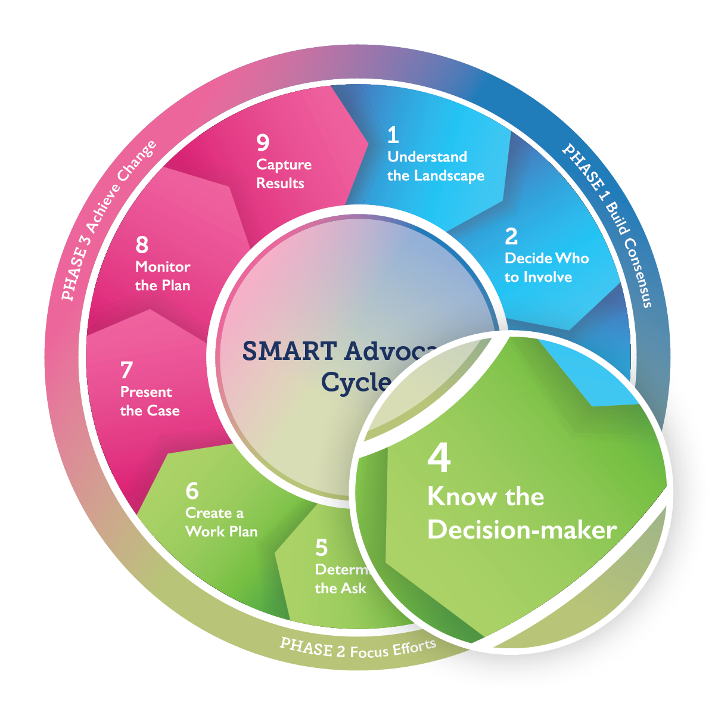
Step 4 Outcome:
Understanding of Decision‑maker
Notes:
At the end of this step, you will confirm that you have identified the right decision-maker and have an understanding of their values, interests, and possible objections to your request.
Make these points:
In Step 4 you will identify a person who has the power to bring about your objective. An advocacy effort is more likely to succeed when you can tailor your advocacy strategy to a specific person.
Also, you will get to know your decision-maker so that you can tailor your advocacy to address them specifically.
User’s Guide pages 33-38.

Slide 46
Step 4—Who Makes the Decisions?
Who has the power to ensure that your issue is addressed?
Examples of decision-makers
Private Sector
Economists
Healthcare providers
Academia
Researchers
Professors
Frontline Workers
Nurses
Teachers
Sanitation Workers
Civil Society
Nongovernmental organizations
Faith-based organizations
Women’s associations
Youth groups
Advocacy officers
Government
Minister of Health
Minister of Gender
Minister of Finance
Advisors to the Minister
Technical officers
Notes:
Briefly review example decision-makers from the slide.
Facilitate a discussion to identify the decision-maker you will address:
Advocates often think that they need to target the highest-level decision-maker. Is this always necessary or most likely to succeed? Why might you want to address a lower-level decision-maker, such as the head of a technical working group?
Make these points:
In order to identify your decision-maker, you need to understand how decisions are made on the issue you want to address. Who in this decision-making structure is best positioned to help us achieve your objective?
You may not want to focus on the highest-level decision-maker, such as the Minister of Health or Finance. Instead, you might target someone who advises the Minister or someone who drafts the budget. Ultimately, your decision-maker should be a gatekeeper who can unlock action on your objective.
Do not assume that there is only one decision-maker. You may need to persuade more than one person or the leadership of a governing body.
It’s easy to confuse decision-makers with messengers (or those who influence decision-makers). Which of the groups on this slide make decisions that can affect policy or funding? Which are less likely to be in that position? Are there any decision-makers missing (e.g., private corporations, donors)?
User’s Guide pages 33-34.

Slide 47
4.1 Confirm Your Decision-Maker
Name:
Position:
Location:
Notes:
Assign 4.1. Facilitate a plenary discussion or break into small groups to identify the key decision-maker(s) needed to achieve your SMART objective:
Ask the participants to keep the following questions in mind:
How are decisions made on your issue?
Who is in the best position to help achieve your objective?
Who can make your objective a reality?
Why is this person important?
Document the identified decision-maker’s name, position, and location on a flip chart sheet, worksheet, or whiteboard. If possible, add a photo of the decision-maker.
User’s Guide page 34.

Slide 48
4.2 Get to Know Your Decision-Maker
Placeholder
Insert photos or statements representing the decision-maker—for example, his/her hometown, place of business, university, hobbies, etc.
Notes:
Make these points:
Now we’re going to get to know your decision-maker. Step 4 consists of exploring all that you know about this person, including how he or she feels about your issue.
You will need to adapt your advocacy strategy so that the decision‑makers see their values reflected in and achieved through your objective.
Facilitate discussion:
Ask participants what they would want to know about their decision-maker before approaching him or her with an advocacy ask?
Optional exercise:
If you have access to WiFi and participants have computers, ask them to search for any information on the decision-maker that is relevant to the goal and landscape assessment.
Adapt the slide:
Insert photos of the decision-maker’s hometown, place of business, university, hobbies, etc.
User’s Guide pages 35-37.

Slide 49
4.2—Get to Know Your Decision-maker
What is the decision-maker’s profession and background?
What is their level of authority in their organization?
Has he or she made any statements or taken any actions for or against your issue?
Is the decision-maker willing and able to act on your issue?
Whose opinions do they care most about?
Notes:
Now that you have identified your key decision-maker, let’s get to know him, her or them.
Make these points:
This slide lists questions that you should answer to get a better sense of your decision-maker’s background, and how likely they might be to support your issue.
As you develop and carry out your strategy, you may find that you need to learn more about the decision-making process and the decision-maker. Keep notes on any gaps in needed information that you recognize.
User’s Guide page 35-37.

Slide 50
4.2—What Does the Decision-maker Value?
[Decision-maker’s photo here]
Socio-economic development
Cost-effectiveness
Youth
Health
Human rights or religious beliefs
Career advancement
Others
Notes:
Make these points:
As you think about your issue from the perspective of your decision-maker, it is important to consider what they value. Your advocacy argument should address what the decision-maker values most. For example:
Is your decision-maker driven by advancing the country’s economy or social development?
Is your decision-maker known to be budget-conscious?
Are young people central to your decision-maker’s agenda?
Is your decision-maker concerned about health or the environment?
Has your decision-maker used human rights or faith-based arguments to justify their actions or position?
Could policy action on your issue help advance the decision-maker’s career or reputation?
Are there public statements, policy actions, or off-the-record intelligence that explain the decision-maker’s values?
Facilitate a discussion:
Ask participants if there is anything else they need to know about a decision-maker’s background, values, and situation.
Slide adaption:
If possible, replace the placeholder box on the slide with a photo of the decision-maker.
User’s Guide page 35-37.

Slide 51
4.2 Get to Know Your Decision-Maker
What is your decision-maker’s core value?
How will saying yes to your ask benefit the decision‑maker?
Notes:
Facilitate 4.2 in plenary or assign as small group work.
Part 1: Of all the values you assessed for your decision-maker, what value appears to be their driving force?
Part 2: Your argument should focus on the positive and convey that the decision-maker’s leadership can make a difference. How will saying yes to your ask benefit the decision-maker?
If assigned in small groups, make sure to facilitate report-outs in plenary.
Document findings on a flip chart sheet, worksheet, or whiteboard.
User’s Guide page 37.

Slide 52
How Do You Approach the Decision-maker?
Uniformed
Knowledgeable
Supportive and Active
Provide and share information
Build knowledge and encourage the will to act
Recognize their leadership and reinforce the action
Notes:
Now that we know our decision-maker better, how might we approach them? That depends partly on what the decision-maker already knows about the issue.
Make these points:
Providing information is the best approach to a decision-maker who does not know much about the issue or does not think it is important. Start by sharing basic knowledge on your specific issue. Explain why the issue is important, what can be done to prioritize it, and what positive outcomes would be expected.
If the decision-maker is already knowledgeable about your issue, encourage them to act: Show that your objective can be accomplished with relative ease, and point to the easiest thing they can do to make a difference.
If your decision-maker is already supportive and active on your issue, recognize their leadership: Thank the decision-maker for past work on the issue, and ask for continued support. Once you have secured a win, celebrate the decision-maker’s role. Expressing appreciation will encourage a decision-maker to act again in the future.
User’s Guide page 38.

Slide 53
For Facilitator Step 5
Set aside at least 2 hours for Step 5. After Step 5 consider taking a break.
Before the session:
Prepare an empty Five-Point Message Box (slide 60) on a flip chart sheet, slide, or whiteboard for each small group.
Prepare a flip chart sheet, slide, or whiteboard with role-play instructions.
In the “practice your advocacy ask” activity:
Each person should practice being both decision-maker and messenger.
The messenger should use arguments developed by the small groups (slide 56) to persuade the decision-maker.
The decision-maker should use the values from Step 4 to respond to arguments.
Use the Message Box to critique each messenger’s ask and responses.
For more tips on facilitating the small group work in Step 5, see the facilitator’s guide.

Slide 54
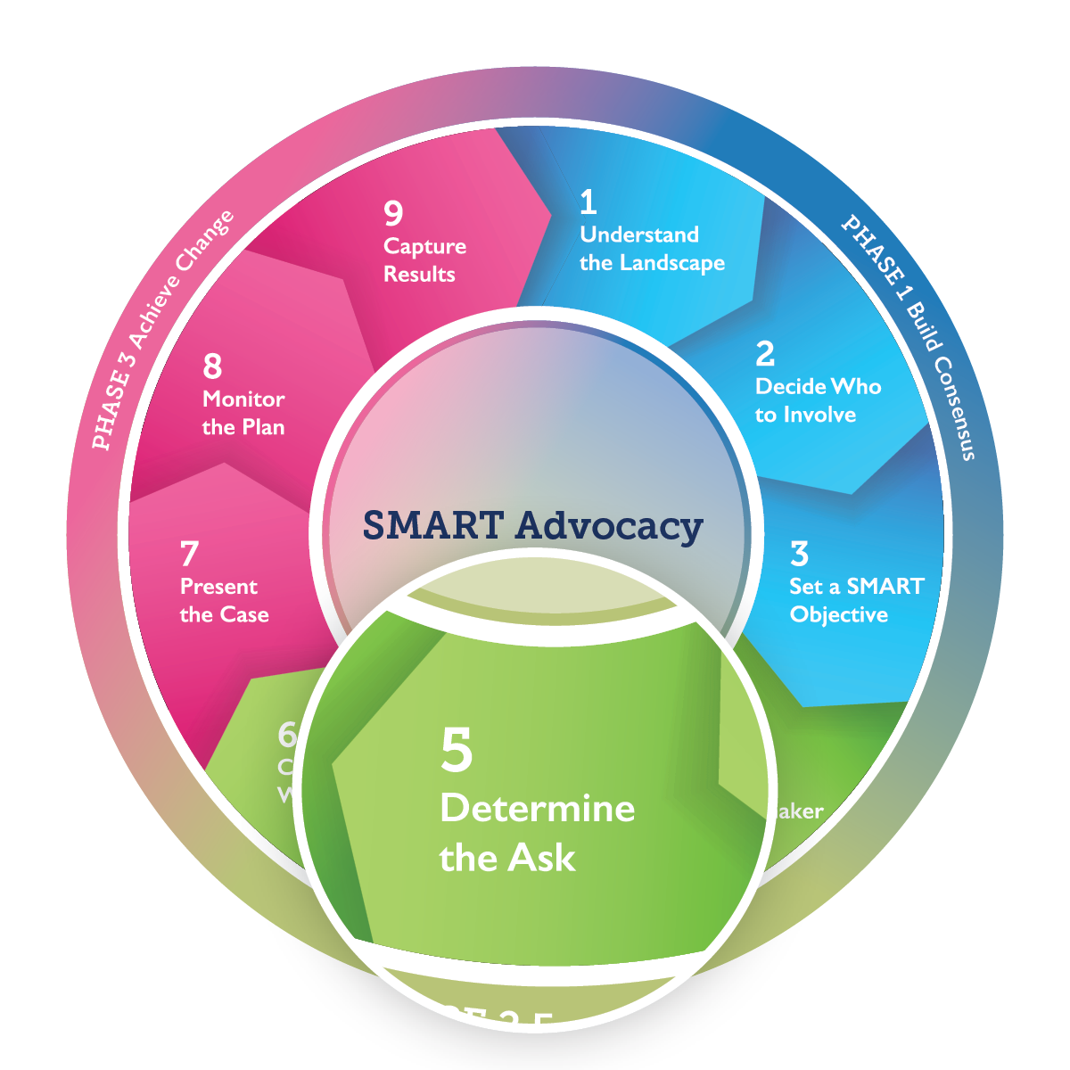
Step 5 Outcome:
Advocacy Ask
Notes:
At the end of this step, you will have a tailored request for action: the advocacy ask.
Make these points:
Now that you know which issues are most important to your decision-maker (Step 4), you need to think about how people make decisions. This will shape how you ask our decision-maker to act—and will help you craft your message in a way that speaks to your decision-maker.
Like your objective, your request to your decision-maker should be SMART.
People decide to act for a variety of reasons, and thus respond to different types of arguments.
In this step you will also decide who should be the messenger to make the ask of the decision-maker.
User’s Guide pages 39-48.

Slide 55
Types of Arguments—the 3 E’s
Support the “ask” with:
Evidence
Use facts, evidence, or first-hand experience
Emotion
Use evocative stories and photos
Ethics
Use a rights- or faith-based approach
Notes:
Make these points:
Before you construct your “ask,” you need to consider the different ways you can support it—with evidence, stories, or rights- or faith-based arguments.
Evidence uses facts and evidence from credible sources. This might include, for example, research findings that identify gaps in access to certain services, promising programs, or operations research approaches. This type of evidence-based argument can help reduce controversy and lead to agreement.
Emotion add a human dimension. They employ personal stories of people affected by your issue to highlight the human problem and show how a policy change could improve lives.
Ethics call on social or cultural norms and a human rights or faith-based approach. They evoke sympathy, the need for justice, and awareness that a decision-maker’s action can affect the lives of others.
As advocates, you need to consider which arguments will be the most compelling for your decision-maker. For example, a policy-maker with a background in medicine or economics may be more interested in evidence, data, and projections about cost, while an elected official may respond to personal stories. Often, a combination of these arguments will be the most convincing message for your decision-maker.
User’s Guide pages 40-41.

Slide 56
5.1 Ways to Argue Your Case—the 3 E’s
Write down evidence-based, emotional, and ethical arguments that support your case.
Evidence | Emotion | Ethics
Notes:
Assign 5.1 in plenary or in small groups:
Brainstorm the evidence-based, emotional, and ethical arguments for your decision-maker to support your advocacy request. Think through the data (evidence), stories (emotional), and ethical arguments that would appeal specifically to your decision-maker.
Write the arguments on a flip chart sheet, worksheet, or whiteboard. If more than one argument in each block, write them all, but choose the best.
Facilitate report-out:
Ask each group to present its best argument in each category. In plenary, discuss which arguments are most likely to influence your decision-maker.
Document the selected arguments on a flip chart sheet, whiteboard, or worksheet and post it.
User’s Guide page 40-41.

Slide 57
Example: From Ask to Advocacy Win
Advocates in Kenya sought to change national family planning guidelines to enable community health workers to provide injectable contraceptives. They developed these arguments:
Evidence | Piloted demonstration project to show that community health workers provide injections safely
Emotional | Recognized nurses’ empathy that women receive high-quality healthcare
Ethical | Stressed that community-based care would overcome inequity between women living in rural and urban areas and among the wealthiest and the poor.
Notes:
Optional slide adaption: If possible, adapt the slide with a local example.

Slide 58
The Five-Point Message Box
2. Enter decision-maker’s core value
(from Step 4.2)
3. Anticipate objections and prepare response
(Step 5.1)
1. Enter decision-maker’s name (from Step 4.1)
5. Answer the question: “What is the benefit?”
(Steps 4.2 and 5)
4. Articulate the SMART ask
(Step 3)
Notes:
Make these points:
This tool, called the Five-Point Message Box, can help you develop a simple request for your decision-maker to take action.
First, you need to name the decision-maker you identified in Step 4. It is better to refer to the decision-maker by name and not title alone; this helps to tailor the message more accurately.
Second, you will input the core value of your decision-maker from Step 4.2. Remember to focus on what is important to your decision-maker, not to us. Consider what he or she cares about most and any public statements made on your issue.
Third, you will anticipate the decision-maker’s objections and reservations and prepare your responses using arguments from 5.1.
Fourth, you will articulate a SMART Advocacy ask. This ask should center on what the decision-maker can realistically do and should reflect your SMART objective.
Finally, you need to answer the question, “What is the benefit for your decision-maker?” Use arguments from Step 4.2 and Step 5. Tell the decision-maker why acting on your ask will benefit his or her constituents or his or her own position—and why his or her leadership can make a difference.
User’s Guide pages 42-44.

Slide 59
The Five-Point Message Box
2. Decision-maker’s core concern: Improving graduation rates
3. Objection: Midwives don’t serve young people.
Response: Girls get pregnant and drop out of school.
1. Decision-maker: State Minister of Finance
5. Benefit: Health gains for underserved groups (e.g., lower maternal mortality, improved graduation rates)
4. SMART ask: Allocate $100,000 in the health budget to hire and train midwives by July 2021.
Notes:
Review the boxes in order.
Facilitate discussion:
Are the messages well developed? Are there any changes they would make? Is the SMART ask truly SMART?
Ask for any questions or suggestions.
User’s Guide pages 42-44.

Slide 60
5.2 The Five-Point Message Box
2. Enter decision-maker’s core values
(from Step 4.2)
3. Anticipate objections and prepare response
(Step 5.1)
1. Enter decision-maker’s name (from Step 4.1)
5. Answer the question: “What is the benefit?”
(Steps 4.2 and 5)
4. Articulate the SMART ask
(Step 3)
Notes:
Assign 5.2. Ideally, this should be done in small groups. Read instructions:
For Boxes 1 and 2, enter the decision-maker’s name and core values from Step 4.1 and 4.2.
For Box 3, consider what objections the decision-maker might make. Their answers from the small group work 5.1 (evidence, emotion, and ethics arguments) will help them decide how to respond to those objections.
For Box 4, state your SMART ask. The SMART ask is usually the SMART objective reformulated in the form of a question.
For Box 5, ask the small group to answer, “What is the benefit?” You can use responses formulated in Steps 4.2 and 5.
Facilitate report-out:
If this is an in-person meeting, this is a good time to get participants on their feet. Have each meeting participant stand up and travel around the room to see the flip charts, in a gallery walk style. One person from each group will report out. Ask the entire group for their suggestions, comments, or questions.
Document findings from each group by taking a photo of the flip chart sheet or whiteboard or save worksheet.
Finalize the message box.
A notetaker should capture the main points for each box to create a working message box.
As you learn more about the policy or funding environment or the decision-maker’s interests, you may add to or revise your message box.
The message box ensures that all members of your group understand your SMART Advocacy ask and how to present it to the designated decision-maker.
User’s Guide pages 42-44.

Slide 61
Select a Messenger
The messenger is as
important as the message.
Policymaker
Celebrity
Community Members
Notes:
Make these points:
Now that you have identified your SMART Advocacy ask and the arguments most likely to sway your decision-maker, you need to choose the messenger most likely to convince the decision-maker to act.
The messenger is as important as the message. A well-crafted message delivered by the wrong person is likely to be dismissed.
Consider who your decision-maker listens to: Who has the authority or influence to convince your decision-maker to act? For example, for a Ministry of Finance official, an economist or a peer from another ministry may be most influential. For others, a colleague or friend might also be the appropriate messenger.
The best messenger may or may not be a current member of your Working Group. If not, you will need to enlist the prospective messenger’s help and fully brief them to make the argument.
Slide adaption:
Replace messenger categories on this slide with different types of messengers appropriate to your context.
User’s Guide pages 45-46.

Slide 62
5.3 Select a Messenger
List the individual or individuals most likely to influence your decision-maker to act.
Name | Title | Phone/Email | Notes
Notes:
Facilitate a plenary discussion or assign 5.3 in small groups:
Who would be the best messenger to deliver the SMART ask? Write their name, title, and contact information on a flip chart sheet or in a worksheet and discuss the pros and cons of each suggestion in the notes section.
Identify the best and most accessible messengers from those you have listed.
If assigned in small groups, make sure groups report out in plenary.
Document findings on a flip chart sheet, worksheet, or whiteboard.
User’s Guide pages 45-46.

Slide 63
Practice Your Advocacy Ask
Will your request be part of an informal discussion or a formal presentation?
How much time will you have to make your case?
Who will ask the decision-maker to act?
How will you follow up after the meeting?
[Insert photo here]
Notes:
Make these points:
After choosing a messenger, you need to decide when and how to deliver the message. There are several factors to consider (read the points in the slide).
At the end of the meeting, quickly review with the decision-maker any follow-up action that you will take and thank the decision-maker for his or her time, regardless of whether the decision-maker’s response was favorable.
You might consider leaving a factsheet, brief or infographic with the decision-maker to reinforce your arguments and provide contact information for follow-up.
Slide adaption:
Add to the box on role-playing a locally appropriate photo or drawing of people in conversation, if available.
User’s Guide pages 47-48.

Slide 64
5.4 Practice through role-play
Role-play a meeting with your decision-maker. Take notes on what worked and did not work.
Role-play notes
Notes:
Practice through role-playing (5.4): Ask the participants to form pairs to role-play the meeting. One person will play the messenger and the other will play the decision-maker.
The “messenger” should use arguments from the Five-Point Message Box. The “decision-maker” should use the values from Step 4, ask questions, and raise objections.
Set a time limit, as your time with the actual decision-maker is likely to be brief.
Do at least two role-plays so that each person can play each role.
After each role-play, ask the pairs to discuss what worked well and what could be improved.
Give one or two pairs the chance to present their role-play in plenary.
Make the role-play as realistic as possible—for example, the decision-maker is interrupted or asks a tough question that you have not prepared to answer.
The actual messenger should be comfortable with all aspects of the message box. If appropriate, they may also benefit from role-playing.
After each group presents, offer positive and constructive feedback. Ask other participants if there is anything the group could do to strengthen their ask to be more persuasive.
Thank everyone for their presentation.
If messengers and advocates are well prepared, their confidence will be evident to the decision-maker.
You may wish to revisit your message box to ensure that it incorporates some of the arguments made to the decision-maker in the role-play.

Slide 65
For Facilitator Step 6
Set aside at least 2.5-3 hours for Step 6, 30 minutes for map your resources and 2-2.5 hours to create the work plan.
Before the session:
Consider organizing Step 6 at a time when your group is most energized. It is a time-intensive step and a good one to schedule for first thing in the morning.
Another option is to end early the previous day, assign one or both exercises as homework and have groups report out first thing on the next day.
Notes:
Facilitation Troubleshooting for Group Work 6.2:
If a working group suggests a public campaign or behavior change activities:
Remind participants the differences among activism, behavior change, media work, and advocacy (see User’s Guide, page 7).
Ask the following prompting questions:
Does this activity address your decision-maker?
Why is this activity needed to achieve your SMART objective?
Is this activity worth the time and cost?
If a group is missing people who are listed as “responsible:”
Recommend that the group schedule a follow-up meeting with all relevant stakeholders or share their draft with others needed to implement the strategy.

Slide 66
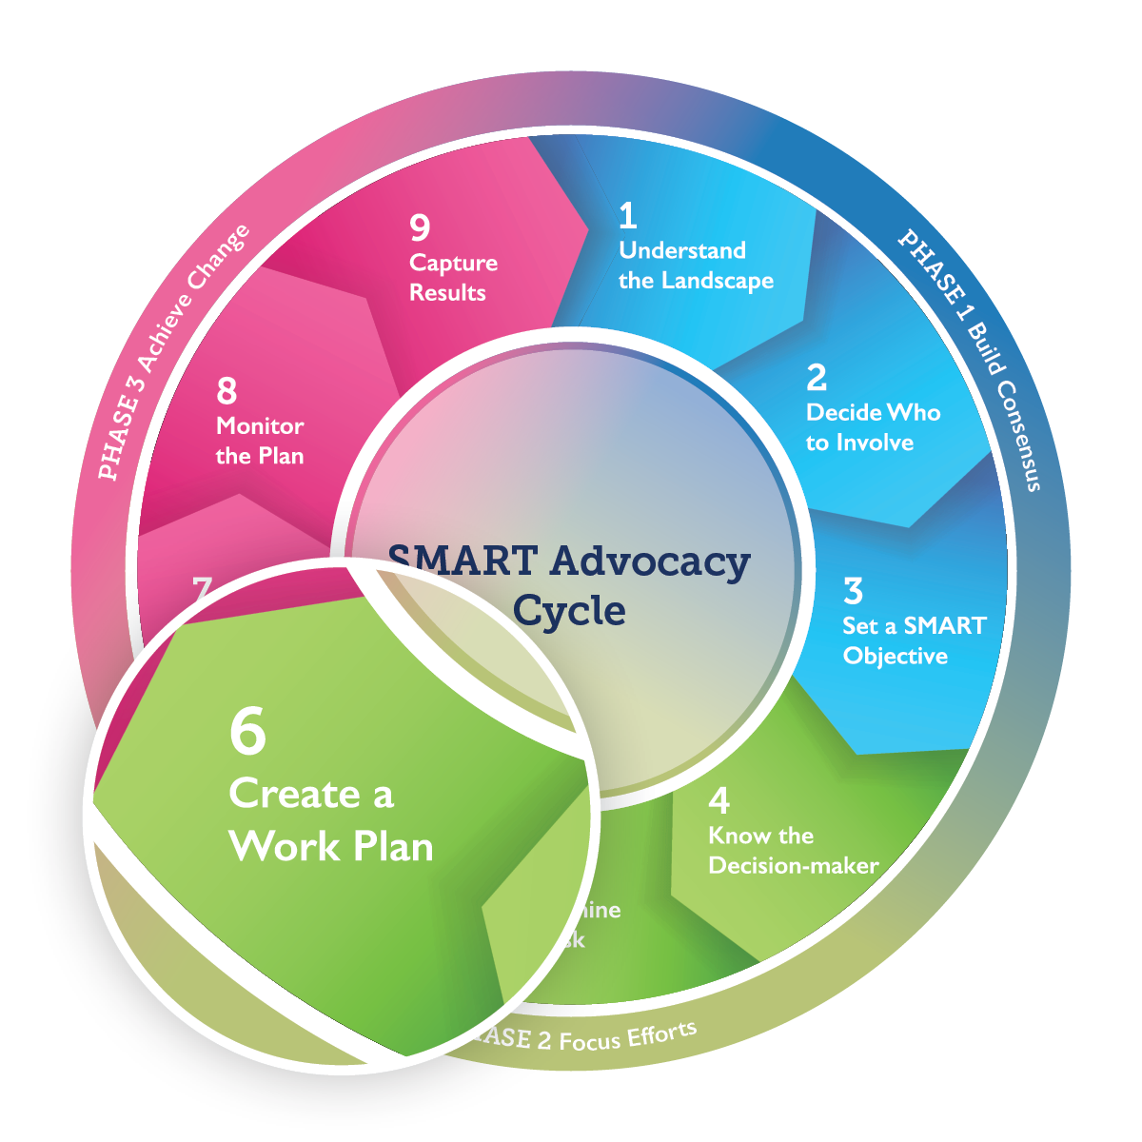
Step 6 Outcome:
Work plan
Notes:
At the end of this step, you will have a detailed work plan.
Make these points:
You have set the stage for reaching your advocacy objective. You are ready to plan in detail who will act, when, and with what resources.
An advocacy strategy focused on advocacy wins rarely includes activities to raise awareness or generate media coverage. Instead, you will focus on taking advantage of existing opportunities to influence a decision—such as the annual budget cycle or review of a specific policy.
In Step 6, you will create an actionable plan, including activities needed to deliver an advocacy win. In developing this work plan, you will decide how and when to reach and interact with your decision-maker, what you can feasibly accomplish, and what each member of the working group can contribute.
Facilitate silent reflection:
Ask participants to identify and list what resources they think is needed to reach the decision-maker and prompt them to act.
You may have them respond by silently answering the question in writing within a defined period (e.g., 5-10 minutes). This will prepare them to respond to the questions on the next slide. It will also ensure that all participants contribute.

Slide 67
6.1 Map Your Resources
Do you have the financial resources?
Do you have the time?
Do you have the data or field reports to support your ask?
Do you have the human resources for implementation?
Do you have access to the decision-makers and those who influence them?
Notes:
Make these points:
This internal review also covers the challenges that you may face in not having sufficient influence, funding, or time to carry out your advocacy strategy.
What assets will you need to support your advocacy effort?
What funding, staff, skills, etc. can your organization or working group members and their organizations contribute?
Do you have the time, clout, and access needed?
In the form on page 50 of the User’s Guide or in your worksheet, indicate “yes” or “no” to answer each question and describe the resource in the next column to the right. If you answer “no,” brainstorm how your advocacy working group will obtain the resource.
Optional: Document findings on a flip chart sheet, worksheet, or whiteboard.
User’s Guide page 50.

Slide 68
6.1 Map Your Resources
Complete the internal review. Indicate ‘yes’ or ‘no’, describe resources and/or how you will obtain them.
Resources | Yes/No | Describe | How will you get it?
Funding? Time? Data? Human Resources? Access?
Notes:
Optional slide to capture outcomes from 6.1.

Slide 69
Step 6.2 Create a Work Plan
Create a detailed work plan with assignments for specific activities. Assign one individual or organization to coordinate the strategy.
Strategy Coordinator:
Activity | Estimated Cost | Responsible Person | Timeline
Notes:
Assign 6.2:
Next, you will brainstorm ideas for advocacy activities. As you do this, test them against the SMART objective that you developed in Step 3, asking the questions on the slide.
Remember that your advocacy strategy is focused on the decision-maker. What steps need to happen to get you in front of your decision-maker to make your SMART ask?
Assign one individual or organization to coordinate the strategy and see that all activities of the work plan are implemented. Estimate costs for each activity and assess whether you have or need enough funding, time, or other resources to carry them out. Then, list who is responsible for implementing the activity.
Set deadlines to track your progress.
Facilitation Tip: Probing questions that can help groups develop a SMART work plan include:
How will the activity further your objective?
How does it relate to what the decision-maker considers important?
Is the activity worth the time and money that it will require?
Is the activity SMART?
What will get us in front of the decision-maker to make the ask?
Document findings on a flip chart sheet, worksheet, or whiteboard.
User’s Guide pages 51-54.

Slide 70
Evaluation
Thank you!
We welcome your feedback.
LOGO
LOGO
LOGO
LOGO
Notes:
Congratulations on finishing Phase 2 of your advocacy strategy! If your goal was to complete an advocacy work plan, you can finish your SMART Advocacy journey here. Otherwise, keep working through Steps 7-9 to incorporate communication, monitoring, evaluation, and learning components.
Ask: What are your immediate actions as this meeting ends? Review your assignments and next steps. Set up the next virtual or in-person follow-up on progress.
Pass out the final evaluation form. Ask participants to fill it in and turn it in before they leave.
Add logos of all organizations leading the facilitation or add the name, organization, and contact information for the facilitator(s).

Slide 71
For Facilitator Phase 3
This phase energizes the advocacy working group to communicate clearly and succinctly, develop a monitoring framework, and continue the advocacy cycle.
You may not be able or want to complete all three SMART Advocacy phases in one facilitation.
You may choose to set up a second facilitation for Phase 3.
Revisiting steps 7-9 after a first-time or recent advocacy win is also helpful.

Slide 72
Phase 3: Achieve Change
Notes:
Make these points:
In Phase 3 you will :
Develop advocacy materials to support the ask
Carry out the strategy
Develop a monitoring plan and
Document your advocacy process to inform future action.
User’s Guide page 56-85.

Slide 73
For Facilitator Step 7
Set aside 20-30 minutes to cover content in Step 7; if using Step 7 to create new or update existing advocacy materials, you may need more time.
Before the session:
Adapt Slide 75 to include a locally relevant communication material.

Slide 74
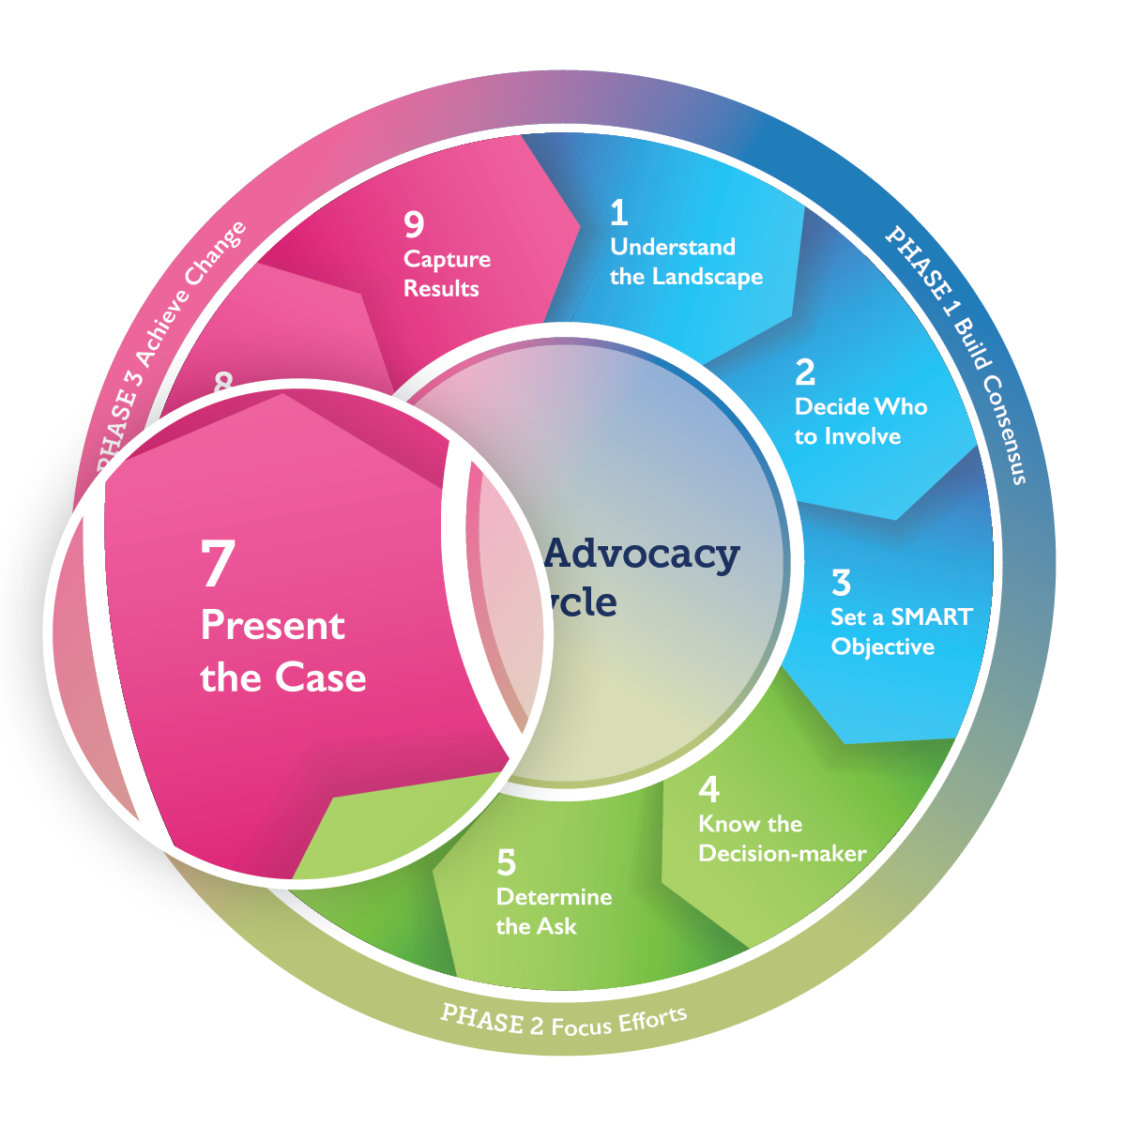
Step 7 Outcome:
Advocacy Materials
Notes:
At the end of this step, you will have advocacy materials to support your advocacy ask. Protocol differs in every setting.
Make These Points:
What materials or data do you need to support your request?
Will your request be part of an informal discussion or require a formal presentation?
Will your meeting be in person or virtual?
What is appropriate professional clothing in this context?
How much time will you have to make your case?
If more than one of you is involved in the meeting, who will present the issue and who will ask the decision‑maker to act?
How will you follow up after the meeting or determine if another meeting needed?
User’s Guide pages 57-61.

Slide 75
Step 7—Develop Materials
Characteristics of good communication:
Clear and succinct—Everything presented supports your SMART objective, for example, on one or two sides of a printed page
Evidence-based—but not technical
Relevant and specific to the place and time
Actionable and urgent
[Insert sample advocacy brief, video, or photo here]
Notes:
Communication materials for the decision-maker can reinforce and support your message.
Facilitate discussion:
What types of communication materials will most resonate with your decision-maker?
What are some characteristics of a good communication material?
In addition to what participants suggest, make these points:
Communication materials can highlight key messages, present research findings, outline crucial challenges, tell or depict with photos a moving personal story (case study), and suggest concrete next steps.
Focus on the decision-maker’s interests and concerns (see Step 4).
Keep content simple. And start at the beginning. Do not assume that the decision-maker already knows as much about the issue as you do.
Materials that are colorful and well-illustrated are more likely to be picked up and read.
Communication materials can use any of the three types of argument discussed in Step 5—evidence-based, emotional, and ethical arguments (see Step 5).
You should plan some materials to leave with the decision-maker, for later reference, after meeting with them. Some decision-makers may appreciate seeing some of your materials before meeting with you. Each of these must identify your group and provide specific contact information that will get the decision-maker a quick response (e.g., a contact person’s name, telephone number, e-mail address).
User’s Guide pages 58-59.

Slide 76
Step 7 — Meet the Decision-maker
Before the meeting
Rehearse by role-playing
During the meeting
Start by stating the importance of your issue
After the meeting
Plan follow-up
Prepare for questions and challenges
Engage the decision-maker in discussion
Make the ask clearly and succinctly. Wait for the answer.
Revise the strategy as needed
Notes:
Make these points:
Before the meeting also:
Try some rehearsals where something goes wrong—e.g., the decision-maker arrives late; the computer will not show your slide presentation.
Decide how and when you will present your communication materials.
Prepare also for the decision-maker’s possible excuses.
Be sure all participating advocates know which one will make the ask.
During the meeting:
Listen to the decision-maker and learn their views. This knowledge will guide future advocacy.
If the decision-maker says he or she cannot decide now, ask how you can help facilitate a decision. For example, would more information be helpful? Would the decision-maker like to hear from someone else—someone he or she trusts and respects?
At the close of the meeting, state any follow-up that you want to promise.
Thank the decision-maker for their time and attention, regardless of his or her answer to your request.
After the meeting:
Make notes or review notes taken during the meeting.
Send the decision-maker a thank-you message.
Debrief with the rest of the Advocacy Working Group by email or a follow-up meeting. Consider what went well and what could have gone better.
Plan and assign responsibility for follow-up actions.
If the meeting did not produce the intended results, do not be overly disappointed. Learn from the experience, revise the approach, and keep trying.
User’s Guide pages 60-61.

Slide 77
For Facilitator Step 8
Set aside at 2-3 hours for Step 8.
Before the session:
Prepare flip chart sheets or a whiteboard with the titles “Outputs,” “Outcomes,” and “Impact” to record the brainstorming exercises.
During the session:
Consider icebreakers or breaks to help retain focus, especially if your group is new to these concepts.

Slide 78
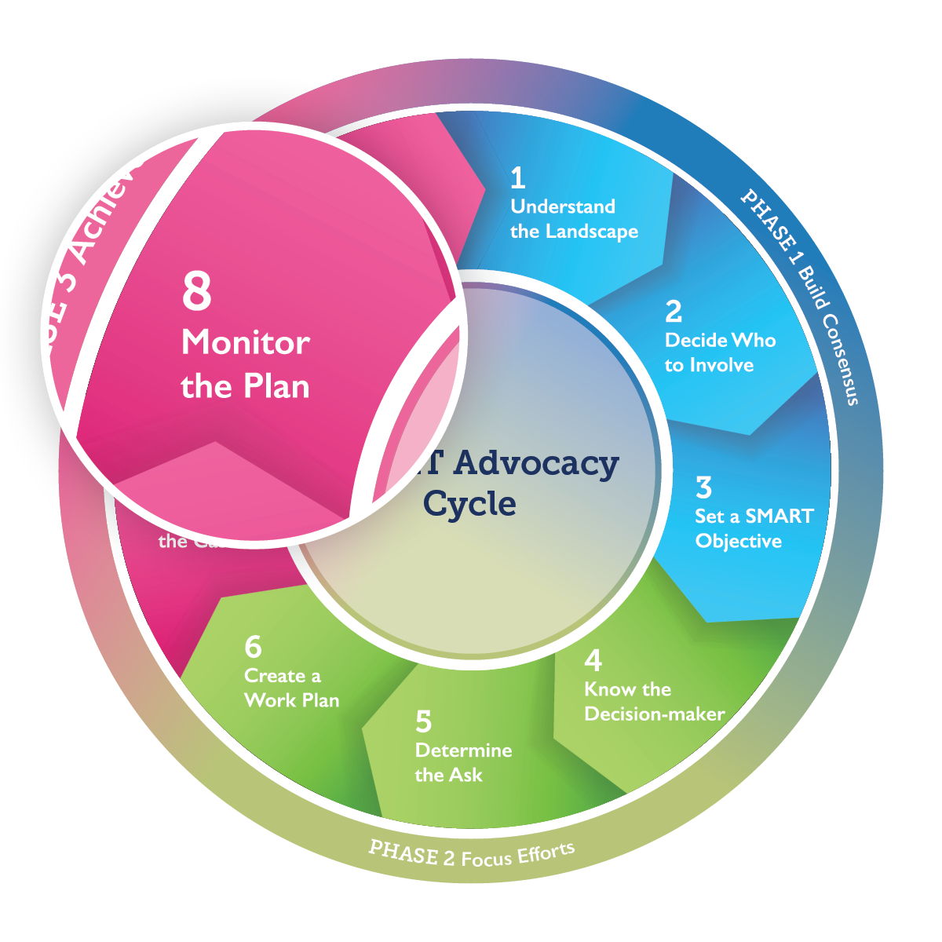
Step 8 Outcome:
Monitoring Plan
Notes:
At the end of this step, you will be able to monitor your work plan, refine your strategy, and document your progress.
Make these points:
The next question you should ask yourselves is, “How will you know if your advocacy efforts are succeeding?”
When you defined a goal and set an objective in Step 3, your group considered how to measure and verify your success (the M in SMART).
Now is the time to translate those ideas into a monitoring plan. What markers or metrics for progress will you track as you implement the activities in your work plan? What indicators of success will you look for when you achieve your advocacy win?
User’s Guide pages 62-79.

Slide 79
We monitor, evaluate, and learn
Because advocacy can produce useful results
To capture longer-term gains from advocacy wins
To better explain the value of investments in advocacy
To keep our eyes on the long-term impact as we track our advocacy wins
To replicate and scale-up success
Notes:
Before showing the content on the slide, facilitate a discussion:
Why might we want to monitor, evaluation, and learn from our efforts?
(Display animation and read any points on slide not mentioned by the participants).

Slide 80
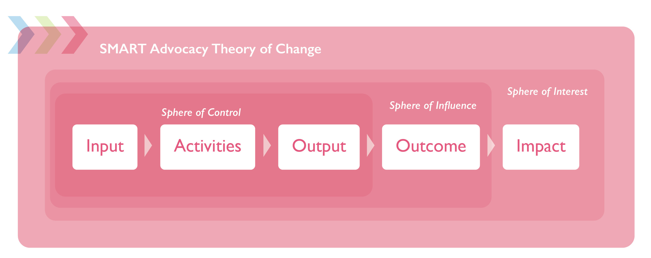
SMART Advocacy Theory of Change
Notes:
Optional slide to understand the connection between outputs, outcomes, and impact.
Make these points:
Most advocacy efforts have a formal or informal theory of change. A theory of change helps to clarify the contribution of advocacy to a policy or funding decision and its result in improving people’s lives or environment or ensuring their human rights.
Your sphere of control—Advocates have the most control over the resources that are contributed to the advocacy process (i.e., inputs) and how those resources are utilized (i.e., activities)
Your sphere of influence—While advocates can create positive conditions for change, the outcome will be influenced by many factors such as the current political situation or a decision‑maker’s mood, etc. Therefore, the outcome is within advocates’ sphere of influence but ultimately will be under the decision‑maker’s control.
Your sphere of interest—SMART Advocacy assumes that reaching impact involves achieving multiple outcomes, including advocacy wins, as well as other changes that may happen independently of advocacy. Thus, you will need to enter the SMART Cycle multiple times to ultimately achieve impact.

Slide 81
Step 8—Three Ways to Measure Results
Outputs—Did you conduct the meetings and produce the materials as specified in your work plan?
Outcomes—Did the decision-maker take the action you asked for (an advocacy win)?
Impact—Did the changes in policy or funding improve the situation or the lives of the intended beneficiaries?
Notes:
Make these points:
There are three ways to measure the success of advocacy efforts. All three are essential to monitoring progress.
Outputs tell us if you carried out the activities in the work plan. This is a measure of productivity—for example, did you hold the meetings that you planned? Did you produce the communication materials that you planned? Did you reach the decision-maker and make your case and request?
Outcomes tell us whether you fulfilled your SMART objective and achieved an advocacy win. Outcomes are generally the effects or changes seen as a result of carrying out the activities in your work plan. They measure the effectiveness of your efforts. Most importantly, did the decision-maker act on your ask?
Impact refers to how the advocacy win has helped the intended ultimate beneficiaries—for example, by improving health or rights. Impact often refers to the advocacy goal. It can be difficult to measure the impact of an advocacy win because (1) it usually takes a chain of advocacy wins to reach the goal and (2) many other factors can influence the impact indicator.
In this causal model of results, outputs cause outcomes, and outcomes cause impact.
The progress monitoring template on slide 88 is designed to also help an advocacy working group record and learn from what went well or could have been improved.
User’s Guide pages 62-65.

Slide 82
Step 8—Measuring Outputs
Outputs
Are under your direct control
Measure your productivity
Are usually quantifiable
Do not guarantee an advocacy win
Examples
Meetings held with decision-makers
Policy briefs or presentations
Gap or landscape analysis report
Notes:
Make these points:
Outputs are a measure of productivity.
They lay the foundation for a SMART objective to be completed, but outputs alone do not guarantee you will achieve the objective.
User’s Guide pages 66-68.

Slide 83
Sample Outputs
Objective: The State Minister of Finance allocates $100,000 in the health budget to hire and train midwives by July 2021.
Activity | Output | Data source
Determine the number of maternal health providers in the state and map gaps in coverage | Gap analysis completed by January 2021 | Copy of printed/electronic gap analysis report
Estimate costs of hiring and training midwives | Costing estimates completed by February 2021 | Copy of costing analysis report
Meet with the State Minister of Finance to present evidence and advocacy ask | Advocacy meeting held with the Minister of Finance by May 2021 | Meeting notes
Notes:
Review the sample outputs table, describing each column and make these points:
The output indicators column identifies specifically what you will measure—your indicators. Good output indicators are those that are (1) expected to produce outcomes and (2) easy to measure.
The “source” column tells us where you will get the data for each indicator. Often, your records and agendas will be the best source of data on events, and invoices and budget ledgers will be the best sources of data on costs.
User’s Guide page 67.

Slide 84
8.1 Outputs
From your work plan, select three key activities most important for you to monitor. Identify the associated output(s) and source(s) you will use to verify them.
Objective:
Activity | Output | Data source
Notes:
Facilitate 8.1 in plenary or assign in small groups and read instructions:
Refer back to the activities listed in your SMART work plan. Select three key activities most important for you to monitor.
What product(s) will you generate as a result of activities implemented?
What sources, tools, or means will you use to measure or verify your output(s)?
Facilitate report-out and/or consensus:
Have participants vote or rank the suggested activities to gain consensus on the three that are most important to monitor.
Document findings on a flip chart sheet, worksheet, or whiteboard.
User’s Guide page 68.

Slide 85
Step 8—Measuring Outcomes
Outcomes
Reflect the effectiveness of your strategy
Tell others if a SMART objective/advocacy win has been achieved
May identify other intended and unintended consequences of the advocacy effort
Examples
Increases in budget allocations, verifiable by official documents
Policy changes, including changes in administrative policy
Programmatic changes resulting from a policy change
Notes:
Make these points:
In the SMART strategy, the intended outcome is the SMART objective. An advocacy win is simply your SMART objective restated. (Read the points on the slide).
Tracking outcomes enables you to validate the achievement of an advocacy win, not just to inform future advocacy, but also to ensure the win is followed through to implementation.
Optional exercise:
If your group is new to the concepts of outputs and outcomes, you might want to use a ‘knowledge check’ at this point. In a knowledge check or quiz, you present examples of outputs and outcomes and ask participants to determine which fall into which categories.
User’s Guide pages 69-71.

Slide 86
8.2 Sample Outcomes
Objective: The State Minister of Finance allocates $100,000 in the health budget to hire and train midwives by July 2021.
Intended outcome | Outcome Indicator | Data source
1a. Budget allocation in the approved state budget for hiring and training midwives | Amount of funds allocated | Official state budget, FY 2021-22
1b. Disbursement of allocated funds to the Ministry of Health | Amount of funds disbursed | Approved state Ministry of Health work plan, quarterly financial reports from the state Ministry of Finance
Notes:
Facilitate Discussion:
Review the sample outcomes table, describing each column and comparing it with the sample outputs table on slide 84.
The outcome indicators column identifies specifically how you will know whether your advocacy succeeded. Ordinarily, this will be stated as whether you achieved your SMART objective. If you did not achieve your SMART objective, the actual outcomes should be recorded.
The right column, “Data source or means of verification,” tells us where to find information that reflects outcomes.
User’s Guide page 70.

Slide 87
8.2 Outcomes
Select at least two outcomes to observe if/when your SMART objective is achieved. Identify an associated indicator(s) and source(s) you would use to verify them.
Objective:
Intended outcome | Outcome Indicator | Data source
Notes:
Facilitate 8.2 in plenary or assign in small groups:
Select at least two outcomes that you expect to observe if/when the objective is achieved.
Start with the outcome directly associated with your SMART objective; then, consider subsequent outcomes that may follow as a result of the win.
What sources, tools, or means would you use to measure or verify your outcome(s)?
Facilitate report-out and document findings on a flip chart sheet, worksheet, or whiteboard.
User’s Guide page 71.

Slide 88
Monitoring Progress Over Time
Notes:
Make these points:
The User’s Guide contains a progress monitoring template which is included on pages 72-74.
Ask for volunteers or assign one member of the advocacy working group to be the monitoring plan coordinator. The monitoring plan coordinator manage updates and completion of the template, but all group members should contribute information and review progress regularly.
The working group should consider the best timing of periodic reviews of the progress monitoring template.
If you have dedicated funding for your advocacy, this template can be used to report results to your funder.
Note that all members of the working group who contributed to outputs may take credit for an advocacy outcome.
Adapt slide:
If you plan to use these in your facilitation, you may need to use the additional progress monitoring template on the SMART Advocacy website.
User’s Guide pages 72-74.

Slide 89
Step 8—Measuring Progress Toward Impact
Impact is achieved by many factors, including advocacy
A constellation of advocacy wins is needed to result in progress toward impact
Impact indicators are factors that help you know if you are making progress toward your goal
As you achieve advocacy objectives, monitor impact indicators and consider overall trends to assess how well your advocacy is contributing to the goal
Notes:
Make these points:
A single advocacy win will not usually produce measurable impact. Rather, it will contribute to a chain of advocacy wins that leads to your goal, which is stated and measured in terms of impact.
Keeping an eye on impact indicators reminds us of our ultimate goal and helps focus short-term efforts.
Impact may often be tracked in terms of regularly collected population health statistics. However, many other factors affect these trends, making attribution difficult.
Proxies for impact may be easier to measure than impact itself. For example, increased childhood immunization rates are known to reduce child deaths. Therefore, if your goal is to increase immunization rates, you can assume that lower child mortality will be an associated impact indicator, but this will take a long time to become apparent.
User’s Guide pages 75-77.

Slide 90
SMART Objectives Mirror Outcomes
Notes:
Facilitate discussion:
How do SMART objectives mirror outcomes?
What impact indicators would you use to assess whether these objectives/outcomes are contributing to fewer women dying in childbirth? (See answers on the subsequent slide).

Slide 91
Example Impact Tracking
Objective: The State Minister of Finance allocates $100,000 in the health budget to hire and train midwives by July 2021.
Intended Impact (Goal Statement) | Impact Indicator(s) | Data source
Fewer women dying in childbirth | Maternal mortality ratio | Demographic and Health Survey (DHS)
Increased use of antenatal services | Percent of women receiving antenatal care during pregnancy Percent of live births attended by skilled health personnel (including midwives) | Health Management Information System (HMIS)
Notes:
Make these points:
The goal of fewer women dying in childbirth is best tracked through 3 impact indicators: maternal mortality ratio, the percent of women receiving antenatal care during pregnancy, and the percent of live births attended by skilled health personnel.
Note the data sources cited to verify these indicators.
User’s Guide page 75.

Slide 92
8.3 Impact
Translate your goal to statements of intended impact. Identify indicators and the associated data sources you will use to track progress toward impact.
Objective:
Intended Impact (Goal Statement) | Impact Indicator(s) | Data source
Notes:
Facilitate 8.3 in plenary or assign in small groups or as homework:
To translate your goal from Step 3 to statements of intended impact.
As multiple advocacy wins are achieved, which indicators will best demonstrate impact?
What sources, tools, or other means will you use to measure, verify, or illustrate your impact?
Document findings on a flip chart sheet, worksheet, or whiteboard.
User’s Guide page 76.

Slide 93
Manage Setbacks
What do you do when setbacks happen?
Stay the course
Revisit the assumptions underlying the strategy
Ask: Has the landscape changed?
Learn from what happened and revise the strategy
Consider whether to revise or pursue a different objective
Notes:
When a setback happens, bring your group together to re-strategize.
Facilitate discussion:
Were original assumptions mistaken or out of date?
Did the window of opportunity close too soon?
Did unexpected events beyond your control change the landscape?
Did implementation go off-track?
Did you identify the wrong decision-maker or messenger?
Did you lack sufficient resources?
Ask participants to suggest other questions that might help explain a setback.
User’s Guide page 78.

Slide 94
Celebrate Success
Notes:
Make these points:
Take time to celebrate wins. Celebration is important. It helps to maintain energy and commitment to keep pursuing the goal.
Consider what contributed to success—both in your own efforts and in external conditions and circumstances, including the contributions of allies and other like-minded people.
Give credit—and thanks—to those who advocated, contributed evidence, time and funds, prepared communication materials, made the advocacy ask, acted to achieve a policy or funding advocacy win.
Thanking our decision-maker both privately and publicly encourages further positive actions.
Bring your group together to set the next SMART objective and begin working toward it (see Step 9).
Slide adaptation: Substitute a locally appropriate exclamation of celebration.
User’s Guide page 79.

Slide 95
For Facilitator Step 9
Set aside at least 2-2.5 hours for step 9 if participants already have an advocacy win and need to draft their own advocacy story.
Before the session:
Consider ending a session early and assigning the story as homework.
Alternatively, you can adapt 9.1 into an elevator speech exercise in which participants must describe the significance of a recent or upcoming advocacy win in 2 minutes or less.
Adapt the evaluation form (slide 105) to include your working group or organization’s logos and contact information.

Slide 96
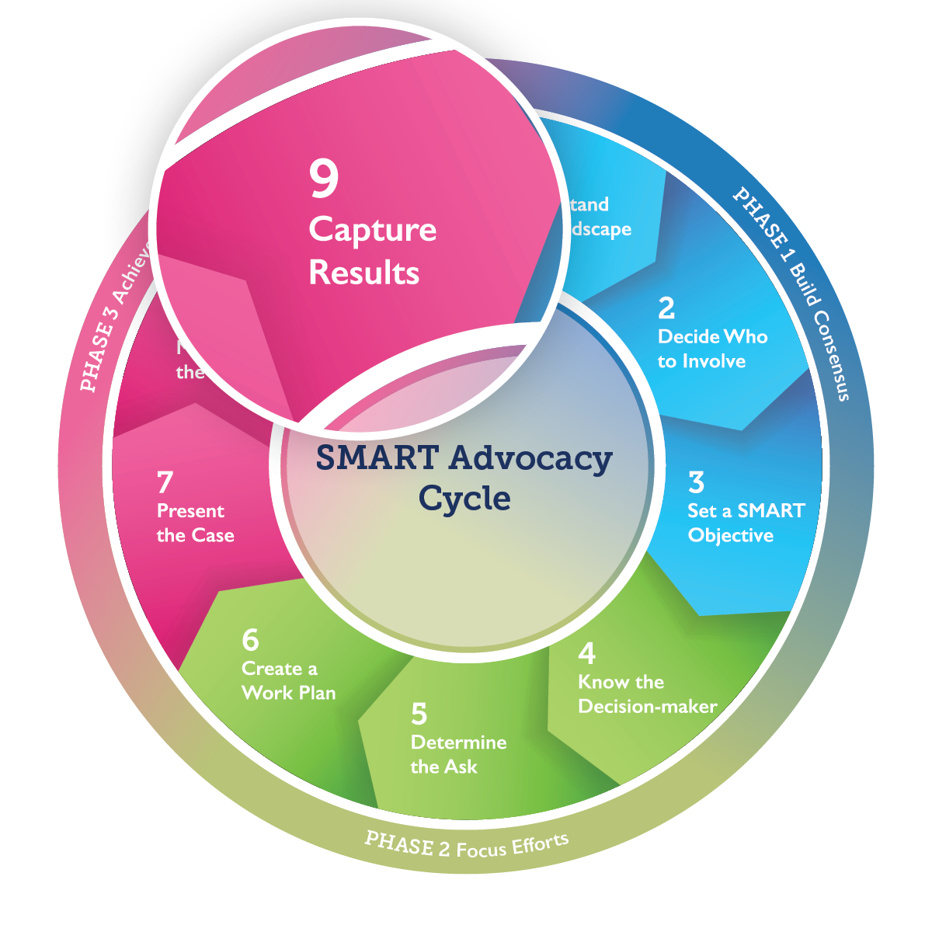
Step 9 Outcome:
Advocacy Story &
Next SMART
Objective
Notes:
At the end of this step, you will know how to tell your advocacy story, set your next SMART objective, and measure your impact.
User’s Guide pages 80-85.

Slide 97
Step 9—Telling Your Story
Why tell your story?
To inform your network and donors
To inspire peers to join you and to act
To enable collaboration and problem-solving
To share lessons learned with other advocates
To enable others to replicate your success
Notes:
Facilitate discussion:
Before displaying the slide’s content, ask the participants: What might be reasons to tell an advocacy story?
If no one else mentions it, you could mention that recording your story will help others understand why you succeeded—lessons you can apply in the future.
(Read any other points on the slide not mentioned by participants).
Ask participants to imagine their recent advocacy win (or their SMART objective, once achieved) as a success story.
Who might want to know about this story? (Possible audiences include donors, other members of the advocacy working group, policy-makers, other organizations.)
What format will work best for this audience? (Possible formats include a written case study, a blog, video, podcast, or a news article.)
How would you get your story out? Depending on the format, there could be multiple channels. Possibilities are presentation at meetings, a website, email, social media, and through news organizations. If working with a news organization, you can ask them to review the story and advise how to strengthen it.
Check with the decision-maker: Is his or her organization going to issue an announcement or press release? If so, do not let your story compete with theirs. Wait a while and try to tell the story from your own angle, to add depth or background, and to promote next steps toward the goal.
User’s Guide pages 80-84.

Slide 98
Step 9.1—Draft Your Story
Use the worksheet or a Word document to draft your advocacy story.
Key Audience: Who do you want to reach and why?
Format: What is the best way to tell your story?
Dissemination plan: How do you plan to share your story with key audiences?
Notes:
You will now use the template to draft your SMART Advocacy story in a Word document or on your worksheet.
Assign 9.1, ideally in pairs or individually. Read instructions across the next 3 slides:
Who do you want to reach with your story?
What is the best way to tell it?
How will you share it?
User’s Guide pages 80-84.

Slide 99
Step 9.1—Draft Your Story
Headline: In 10 words or fewer, summarize the advocacy outcome and why it is important.
Summary and key message: What is the significant change you are reporting?
Context: What context is necessary to understand the significance of the advocacy win? Provide relevant baseline data, if available.
Notes:
Continue to read instructions;
You will use a news-story approach when drafting.
Start with a short statement of the most important point: an important policy or funding change has taken place. State this in one sentence if possible. This will be your headline.
Next, explain briefly the significance of the change—why it is important, who will benefit and how.
Then explain any context—baseline data or background information.
Overall, organize the content in order of decreasing importance. Some people may stop reading or watching as your story goes on.
Make sure that they get the most important points as quickly as possible. Put the least important information at the end.
User’s Guide pages 80-84.

Slide 100
Step 9.1—Draft Your Story
Strategy and Recognition: Explain key aspects of your advocacy strategy. Include the names of all relevant partners and policymakers who should receive credit.
Implications and next steps: What is expected to happen next? How will this affect your future activities or ability to reach your goal?
Quotes and photos [optional]
Notes:
Continue to read instructions;
Keep description of the advocacy strategy brief. The audience is not likely to be interested in all the details.
In giving credit, give top billing to the decision-maker. Also, be sure to mention allies and contributors.
Once finished, ask participants to swap story drafts and provide constructive feedback to the writer.

Slide 101
Step 9—Telling Your Story
Telling your story starts the process of reflecting on what did and did not go well.
It connects trends in impact data—that you are already monitoring—with advocacy activities and outputs that contributed to your win.
Consider researching how other organizations have told their advocacy stories. You can find AFP’s on advancefamilyplanning.org.
Notes:
Optional activity:
Share a short video, presentation, or podcast that tells an advocacy story.
Ask participants to critique whether it is effective and why or why not using the criteria outlined in bullet one and two on this slide.

Slide 102
Step 9—Choosing the Next SMART Objective
Citation: Stachowiak, S., Robles, L., Habtemariam, E., & Maltry, M. (2016, January). Beyond the Win: Pathways for Policy Implementation. ORS Impact.
Notes:
Now is the time to consider your next advocacy objective.
Make these points:
Advocacy is a process. Each advocacy win builds on the one before it to make progress toward impact.
An advocacy win may be a decision to change policy or funding, but you need to monitor to make sure the change is carried out. Even just checking in with the decision-maker may be enough to make sure the decision has consequences.
At every step from advocacy strategy formulation to strategy implementation and evaluation, you will need to review and update the landscape assessment.
Are new windows of opportunity opening? Have the key decision-makers changed (due to an election, retirement or people moving to new jobs, for example)?
In developing your second, third, fourth, or hundredth SMART advocacy objective toward the same goal, following the SMART Advocacy cycle will be faster.
Nevertheless, you will always need to adapt your plan to new circumstances.
User’s Guide pages 85-87.

Slide 103
Step 9—Choosing the Next SMART Objective
Re-assemble the advocacy working group
Reflect on what led to success or a setback
Restart the SMART Advocacy cycle
Update the landscape assessment and review impact indicators
Choose the next SMART objective
Check: Is continued advocacy needed for implementation of the recent advocacy win?
Notes:
Facilitate a discussion:
How should you choose the next SMART objective? Possible options include:
The criteria you used to pick your first SMART objective (Step 2) will help you choose the next objective, too.
Any current or imminent windows of opportunity from your updated landscape assessment.
Or can you go back and ask more help from the decision-maker who just gave you your advocacy win?
Is there a necessary order of events that you must follow? If so, what must come next? For example, if a new policy has authorized new services, does funding for the new services now need to be budgeted?
User’s Guide pages 85-87.

Slide 104
Time to Act
What are your immediate actions as this meeting ends?
Review your assignments and next steps
Set up the next virtual or in-person follow-up on progress
Evaluate progress against indicators to ensure that you stay on track
Notes:
Note that it is important to have a follow-up plan to build on the momentum of this workshop. If possible, set the date for the next meeting and decide how it will take place—in person or virtually (for example, by telephone or by virtual conferencing software).
Ask participants to meet in their small groups one last time to discuss assignments, next steps and any questions or clarifications to ask of the entire group in plenary before the meeting ends. Ensure that the group and individual members know and agree on their next steps and how the advocacy strategy will move forward.

Slide 105
Evaluation
Thank you!
We welcome your feedback.
LOGO
LOGO
LOGO
LOGO
Notes:
Pass out the final evaluation form. Ask participants to fill it in and turn it in before they leave.
Add logos of all organizations leading the facilitation or add the name, organization, and contact information for the facilitator(s).

